Slide 1
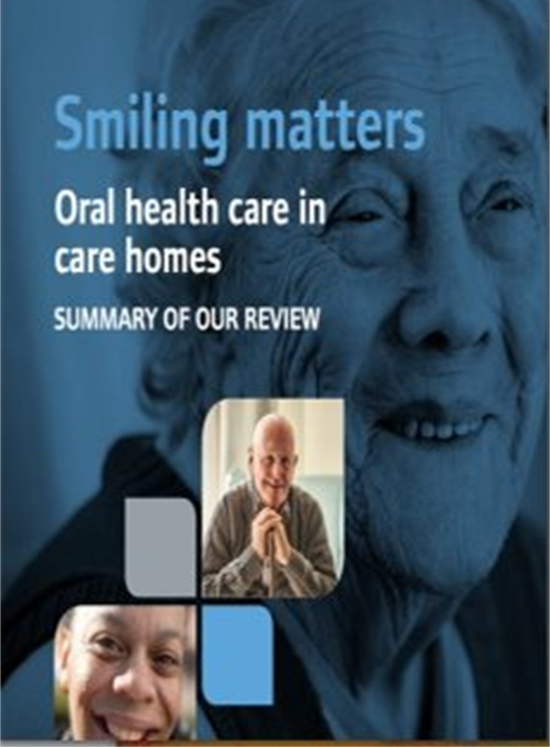
MOUTH CARE MATTERS IN THE COMMUNITY
Training for community managers
Section 1
Notes:
Welcome to section 1 of the e-learning package Mouth Care Matters in the Community. – Training for Community managers.
In this section we will cover why mouth care is important, the national drivers that set out what is needed and management roles and responsibilities
When you have completed the training please complete the assessment where you have the opportunity to give comments and feedback. You can also access a training certificate. If you have any queries of suggestions please email dwt@nhs.net

Slide 2
This slide set has been produced by the following partner organisations for use within the North West Region
Disclaimer
The authors take no responsibility for any actions undertaken when following this guidance. Health and Social Care professionals should only carry out procedures that they are trained in and that are within their competencies.
Mouth Care Matters - SECTION 2
Editor(s) | NHS England – Queries /comments should be emailed to DWT@nhs.net
Contributors | Lesley Gough, Lynne Smith, Vicky Brand, Sue Hodgkiss, Helen Parsley and Emma Stonier
Version | 2
Issue date | October 2020
1st Review Next Review | October 2023 October 2025
Notes:
This training material has been developed by the following organisations for use across the NorthWest of England

Slide 3
Contents
Learning outcomes
Rationale
National drivers
National Institute of Clinical Excellence (NICE) requirements
Care Quality Commission (CQC) requirements (2019)
The NHS Long Term Plan (2019)
Key priorities
Management roles and responsibilities
Notes:
Contents of this package:-
Learning outcomes
Rationale of mouth care and why it is needed
The National drivers to mouth care policy – including
National Institute of Clinical Excellence (NICE) requirements
Care Quality Commission (CQC) requirements (2019)
The NHS Long Term Plan (2019)

Slide 4
Learning outcomes
Participant will gain an increase knowledge and understanding of:
Why mouth care is important
The links between oral health and general health
NICE guidance and quality standards for mouth care in a care setting
CQC requirements for mouth care in care setting
The NHS Long Term Plan
Key mouth care priorities
Management roles and responsibilities
Notes:
Participant will gain an increase knowledge and understanding of:
Why mouth care is important
The links between oral health and general health
NICE guidance and quality standards for mouth care in a care setting
CQC requirements for mouth care in a care setting
The NHS Long Term Plan
Key mouth care priorities
Management roles and responsibilities

Slide 5
Why mouth care is essential?
An essential part of promoting good health and quality of life for vulnerable people and people with learning disabilities
Good oral health enables people to communicate effectively
Helps in ability to eat and enjoy a variety of foods
Care providers are delivering more complex care for an increasing number of vulnerable and older people
People are living longer and have complex health and social care needs
Notes:
Why mouth care is essential?
Mouth care is an essential part of promoting good health and quality of life for vulnerable people and people with learning disabilities
Good oral health enables people to communicate effectively
Helps in ability to eat and enjoy a variety of foods
Care providers are delivering more complex care for an increasing number of vulnerable and older people.
People are living longer and have complex health and social care needs

Slide 6
Good mouth care and independence are linked
Loss of function - physical or cognitive can impact on people's ability to care for their mouth and rapidly increases the risk of dental disease.
The risk of dental disease increases quickly when someone has:
Dementia
A degenerative illness
Suffered a stroke
Autism
Acquired a brain injury
A mental health condition
Severe learning difficulties
Notes:
Good mouth care and independence are linked
Loss of function - physical or cognitive can impact on people's ability to care for their mouth and rapidly increases the risk of dental disease.
The risk of dental disease increases quickly when someone has:
Dementia
A degenerative illness – such as Parkinson’s disease or motor neuron disease
Has Suffered a stroke
Has Autism
Has an Acquired a brain injury
A mental health condition
Or has Severe learning difficulties

Slide 7
People with good oral health are able to eat and drink properly, helping them take part in life, stay independent for longer and recover from episodes of frailty more quickly.
Poor oral health impacts on:
Dignity, general health and well-being and quality of life
Hydration and nutrition
Comfort, mood and behaviour
Speech
Ability to smile, communicate, eat and swallow
Self-confidence
Poor oral health is also linked with aspiration pneumonia, diabetes, coronary heart disease, strokes and peripheral vascular disease
Notes:
People with good oral health are able to eat and drink properly, helping them take part in life, stay independent for longer and recover from episodes of frailty more quickly.
Poor oral health impacts on:
Dignity, general health and well-being and quality of life
Hydration and nutrition
Comfort, mood and behaviour
Speech
Ability to smile, communicate, eat and swallow
And also Self-confidence
Poor oral health is also linked with aspiration pneumonia, diabetes, coronary heart disease, strokes and peripheral vascular disease

Slide 8
National drivers
2016
NICE Guidance (NG 48) Oral health for adults in care homes
2017
NICE Quality Standard (QS151) Oral health in care homes
2019
CQC Smiling Matters Report
2019
The NHS Long Term Plan
Notes:
There are many national drivers or policies that have helped shape oral health programs in care settings over the last 4 years.
In 2016 NICE guidance NG48 – Oral health for adults in care homes was produced
In 2017 NICE added 3 Quality Standards that should be met when providing Oral care in care homes
In 2019 the NHS long term plan was produced and included Oral care as a way of Improving population health. The CQC published the Smiling Matters report in the same year.

Slide 9
NICE guidance and quality standards National Institute for Clinical Excellence (NG 48) Improving oral health in care homes (2016)​
Notes:
This guideline covers oral health, including dental health and daily mouth care, for adults in care homes. The aim is to maintain and improve their oral health and ensure timely access to dental treatment.

Slide 10
NICE guidance (NG 48)
The guidance is for care staff carrying out admissions, assessments and provision of daily mouth care
Care staff are required to assess the mouth care needs and preferences of all individuals within 24 hours of arrival, and regularly review these utilising a mouth care assessment tool, regardless of the length or purpose of their stay
Where carers, family and friends are involved in ongoing care, with permission, consider involving them in the initial assessment if it will help staff understand the individual’s usual oral hygiene and mouth care needs and preferences
Consider how the individual usually manages their daily mouth care
Record the results of the assessment and any clinical appointments in the individual’s personal mouth care plan
Review and update individual mouth care needs in their personal mouth care plan as needs and preferences change
Notes:
The guidance is for care staff carrying out admissions, assessments and provision of daily mouth care
Care staff are required to assess the mouth care needs and preferences of all individuals within 24 hours of arrival, and regularly review these utilising a mouth care assessment tool, regardless of the length or purpose of their stay
Where carers, family and friends are involved in ongoing care, with permission, consider involving them in the initial assessment if it will help staff understand the individual’s usual oral hygiene and mouth care needs and preferences
Consider how the individual usually manages their daily mouth care
Record the results of the assessment and any clinical appointments in the individual’s personal mouth care plan
Review and update individual mouth care needs in their personal mouth care plan as needs and preferences change

Slide 11
QS1. Mouth care assessment in care setting
QS2. Recording mouth care needs in care plan
QS3. Supporting daily mouth care in care setting
NICE Quality Standards (QS 151)
Further information
NICE Guidance (NG48) https://www.nice.org.uk/guidance/ng48
NICE Quality Standard (151) https://www.nice.org.uk/guidance/qs151
Notes:
NICE Quality Standards QS151 are 3 principles that must be met in order to meet the NICE guidance standards
No.1 covers Mouth care assessment in care settings
No.2 covers recording mouth care needs in the care plan
No.3 covers supporting daily mouth care in care settings

Slide 12
NHS LONG TERM PLAN (2019)
Prevention and health inequalities
Improving population health
Integrated care systems
Supporting health and care professionals
Helping people to age well
Improving care for care home residents
Notes:
The final national driver for mouth care is the NHS long term plan and this gives guidance on:-
Prevention and health inequalities
Improving population health
Integrated care systems
Supporting health and care professionals
Helping people to age well
Improving care for care home residents

Slide 13
Care Quality Commission Smiling Matters
Notes:
The next guidance to consider is from the Care quality commission and is titled Smiling Matters.
This report details what the CQC found when it reviewed the state of oral health care in care homes across England.

Slide 14
CQC Smiling Matters report (June 2019)
CQC watchdog report (based on visits to 100 homes) found:
Residents did not always have access to a dentist
Residents were not getting the support they needed to look after their teeth
Around half of the homes did not provide training for their staff on oral health care
Nearly three-quarters of individual care plans did not cover oral health sufficiently
One-in-six care homes reported they did not assess resident's oral health on admission
Notes:
CQC watchdog report was based on visits to 100 care homes and found:
Residents did not always have access to a dentist
Residents were not getting the support they needed to look after their teeth
Around half of the homes did not provide training for their staff on oral health care
Nearly three-quarters of individual care plans did not cover oral health sufficiently
One-in-six care homes reported they did not assess resident's oral health on admission

Slide 15
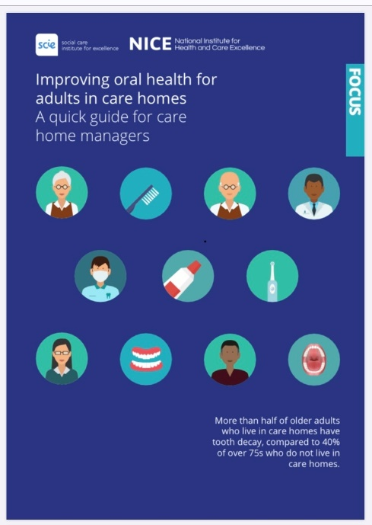
CQC expects
Care providers and managers to take account of nationally recognised guidance demonstrating evidence of how they support those they care for to maintain good oral health
All care staff have oral health training
All individuals should have a mouth care assessment, an individual mouth care plan on arrival and access to a dentist – this needs be evidenced
Notes:
During a CQC inspection certain standards and paperwork would be expected to be in place:
These would include -
Care providers and managers to take account of nationally recognised guidance demonstrating evidence of how they support those they care for to maintain good oral health – a copy of the NICE guidelines (or the Quick guide for managers), should be stored with any mouth care information
All care staff should have oral health training – This is documented evidence of what training has been provided for staff and when this training will be renewed
All individuals should have a mouth care assessment, an individual mouth care plan on arrival and access to a dentist – this needs be evidenced. A copy of the mouth care assessment and care plan should be present in the personal care file

Slide 16
Challenges of ensuring good mouth care
CARERS:
may not know how best to clean someone else’s mouth and dentures
may not recognise the impact good mouth care has in relation to dignity, health and general well-being
may not know that poor mouth care is related to other health conditions such as aspiration pneumonia, diabetes, coronary heart disease, strokes and peripheral vascular disease
may consider it distasteful or invasive to clean someone else’s mouth and dentures
may have concerns and confusion about mental capacity and consent
Notes:
Challenges of ensuring good mouth care
Certain challenges may exist that prevent good mouth care. These can include:-
Carers may not know how best to clean someone else’s mouth and dentures - It is difficult to know how best to clean someone else’s mouth, – this requires training
Carers may not recognise the impact good mouth care has in relation to dignity, health and general well-being
Also carers may not know that poor mouth care is related to other health conditions such as aspiration pneumonia, diabetes, coronary heart disease, strokes and peripheral vascular disease
Some carers may consider it distasteful or invasive to clean someone else’s mouth and dentures
And there may be concerns and confusion about mental capacity and consent

Slide 17
Challenges of ensuring good mouth care
CARERS
may not know how to support people who are resistant to mouth care
may be under time pressure and experience a high turnover of staff in some areas
may be unaware of the products and techniques that can help with the provision of good daily mouth care
may be unaware of the common oral health conditions and diseases and how to facilitate appropriate access to dental services
unaware of NICE guidance and the quality standards required for CQC compliance in relation to mouth care
Notes:
There may also be concerns about how to support people who are resistant to mouth care, particularly those with frailty, additional needs, disabilities or medical complexities
There are many pressures of time on care staff and sometimes a high turnover of staff in some areas
Not all carers may be aware of the products and techniques that can help with the provision of good daily mouth care
Carers may not be aware of the common oral health conditions and diseases and how to facilitate appropriate access to dental services
There may be some carers who are not aware of NICE guidance and the quality standards required for CQC compliance in relation to mouth care

Slide 18
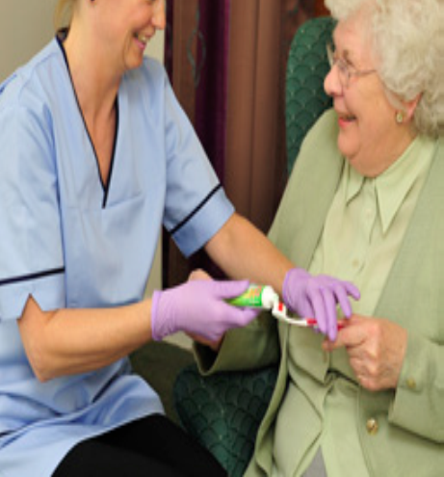
KEY PRIORITIES
Putting the mouth back into the body
Recognising that poor oral health impacts on dignity, general health and well-being
Encouraging self-care, as well as up-skilling and increasing carer’s knowledge and confidence in delivering mouth care, and facilitating access to dental services
Ensuring mouth care is integrated into general personal care
Ensuring that all individuals have a mouth care assessment and a personal mouth care plan, that can be evidenced
Nominating a mouth care champion(s) for all care provider organisations
Engagement with carers, family and friends
Notes:
KEY PRIORITIES of mouth care include
Putting the mouth back into the body and Recognising that poor oral health impacts on dignity, general health and well-being
Also Encouraging self-care, as well as up-skilling and increasing the carer’s knowledge and confidence in delivering mouth care, and facilitating access to dental services
Ensuring mouth care is integrated into general personal care
And ensuring that all individuals have a mouth care assessment and a personal mouth care plan and evidence of this can be produced.
Key priorities also include Nominating a mouth care champion(s) for all care provider organisations
Engagement with carers, family and friends

Slide 19
Good mouth care should be the concern of the whole multi-disciplinary care team and regarded as an essential aspect of personal care for all
Management roles and responsibilities
It is the responsibility of the care provider manager to ensure:
Mouth care is integrated into local care setting core management frameworks, policies and procedures, in-line with NICE guidance and quality standards
All individuals have a mouth care assessment within 24 hours of arrival, conducted by an appropriately trained team member
All individuals have a daily mouth care plan, that is reviewed regularly to ensure that it meets individual needs and/or preferences
Notes:
Management roles and responsibilities
Good mouth care should be the concern of the whole multi-disciplinary care team and regarded as an essential aspect of personal care for all
It is the responsibility of the care provider manager to ensure:
Mouth care is integrated into local care setting core management frameworks, policies and procedures, in-line with NICE guidance and quality standards
2. All individuals have a mouth care assessment within 24 hours of arrival, conducted by an appropriately trained team member
3. All individuals have a daily mouth care plan, that is reviewed regularly to ensure that it meets individual needs and/or preferences

Slide 20
It is the responsibility of the care provider manager to ensure:
All staff know how to facilitate access to urgent or routine dental care
All individuals have access to mouth care equipment, such as toothbrushes, toothpaste, dry mouth and denture cleaning and marking products, appropriate to need and/or preferences
All staff understand their role and responsibility to deliver safe daily mouth care regarding infection control and adherence to the Health and Social Care Act 2008, Code of Practice 2010 and local policies and procedures
Management roles and responsibilities
Notes:
All staff know how to facilitate access to urgent or routine dental care
All individuals have access to mouth care equipment, such as toothbrushes, toothpaste, dry mouth products and denture cleaning and marking products, appropriate to need or preferences
All staff understand their role and responsibility to deliver safe daily mouth care regarding infection control and adherence to the Health and Social Care Act 2008, Code of Practice 2010 and local policies and procedures

Slide 21
All staff have access to and understand their responsibility in relation to consent and the Mental Capacity Act 2005, Deprivation of Liberty Safeguards and Lasting Power of Attorney
All staff understand the importance, with permission, the need to engage with carers, family and friends on issues related to mouth care and access to urgent or routine dental care
That there are processes in place to audit, monitor and evidence quality standards in relation to local policies and procedures for CQC compliance related to mouth care
That any adverse events or challenges are reported via local systems to highlight learning and where improvement may be needed
All staff receive mouth care training that is regularly updated (for best practice approximately every two years)
Management should also ensure
Notes:
Management should also ensure
All staff have access to and understand their responsibility in relation to consent and the Mental Capacity Act 2005, Deprivation of Liberty Safeguards and Lasting Power of Attorney
Also that all staff understand the importance, with permission, the need to engage with carers, family and friends on issues related to mouth care and access to urgent or routine primary dental care
That there are processes in place to audit, monitor and evidence quality standards in relation to local policies and procedures for CQC compliance related to mouth care
That any adverse events or challenges are reported via local systems to highlight learning and where improvement may be needed
And that all staff receive mouth care training that is regularly updated (for best practice approximately every two years)

Slide 22
SUMMARY
Good daily mouth care
Adopt nationally recognised guidance
Oral health training every two years
Assess mouth care needs within 24 hours of arrival
Review using a mouth care assessment tool
Involve family / friends in assessment and preferences
Facilitate access to appropriate dental care
Notes:
So in summary of this section - It is paramount that health and social care staff understand the importance of good daily mouth care and how this is linked to dignity and general health and well-being
1. The CQC expect all care providers and managers to take account of nationally recognised guidance demonstrating evidence of how they support those they care for to maintain good oral health
2. All care staff must have oral health training (best practice - approximately every two years)
3/4. Care staff are required to assess the mouth care needs and preferences of all individuals within 24 hours of arrival, and review these regularly using a mouth care assessment tool, regardless of the length or purpose of their stay
5. Where carers, family and friends are involved in ongoing care, with permission, consider involving them in the initial assessment if it will help staff understand the individual’s usual oral hygiene and mouth care needs and preferences
6. And Care staff must know how to facilitate access to appropriate dental care

