Slide 1
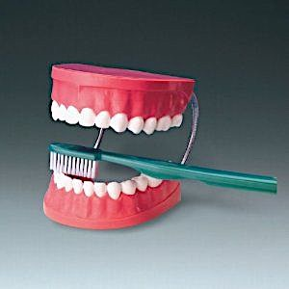
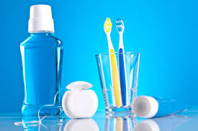

MOUTH CARE MATTERS IN THE COMMUNITY
Mouth Care Products
Section 10
Notes:
Welcome to section 10 of the e-learning package Mouth Care Matters in the Community. – Mouth care products
In this section we will cover the products available to assist with mouth care. This is not an exhaustive list and this presentation is not affiliated with any brand, company or product

Slide 2



This slide set has been produced by the following partner organisations for use within the Northwest Region
Disclaimer
The authors take no responsibility for any actions undertaken when following this guidance. Health and Social Care professionals should only carry out procedures that they are trained in and that are within their competencies.
Mouth Care Matters - SECTION 10
Editor(s) | NHS England – Queries /comments should be emailed to DWT@nhs.net
Contributors | Lesley Gough, Lynne Smith, Vicky Brand, Sue Hodgkiss, Helen Parsley and Emma Stonier
Version | 2
Issue date | October 2020
1st Review Next review | October 2023 October 2025
Notes:
This training material has been developed by the following organisations for use across the north west of England

Slide 3
Learning outcomes
Participant will gain an increase knowledge and understanding of the following oral health products and how they can help with mouth care:
Toothpastes
Mouthwashes
Toothbrushes and adaptions
Interdental products
Products to help with a dry mouth
Oral Cleansers
Mouth props
Notes:
Learning outcomes
Participant will gain an increase knowledge and understanding of the following oral health products and how they can help with mouth care:
Toothpastes
Mouthwashes
Toothbrushes and adaptions
Interdental products
Products to help with a dry mouth
Oral Cleansers
Mouth props

Slide 4
Oral Health Products
All individuals must have access to the oral health products they require for good daily mouth care
With permission, it is good practice to engage with carers, family and friends who may wish to be involved with all aspects of mouth care
Ensure individual needs and preferences are assessed and recorded in their oral care plan and includes anything prescribed by their dentist or doctor
For example: Chlorhexidine products, higher concentration fluoride toothpaste or mouthwash, non-foaming toothpaste, antifungal rinse/creams, saliva substitutes
Notes:
Oral Health Products
All individuals must have access to the oral health products they require for good daily mouth care
With permission, it is good practice to engage with carers, family and friends who may wish to be involved with all aspects of mouth care
Ensure individual needs and preferences are assessed and recorded in their oral care plan and includes anything prescribed by their dentist or doctor
For example: Chlorhexidine products, higher concentration fluoride toothpaste or mouthwash, non-foaming toothpaste, antifungal rinse and creams and saliva substitutes

Slide 5
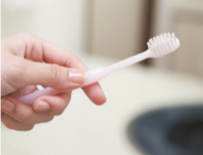
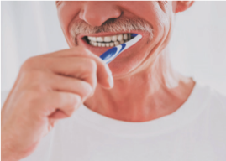
Cont’d
Ensure that individual needs and preferences are regularly reviewed
All people irrespective of whether they have any natural teeth or not should visit a dentist for a routine dental check-up at least once per year
Any concerns, always seek the advice of a dental care professional
Notes:
Ensure that individual needs and preferences are regularly reviewed
All people irrespective of whether they have any natural teeth or not should visit a dentist for a routine dental check-up at least once per year
If you are concerned about anything connected with the mouth always seek the advice of a dental care professional

Slide 6
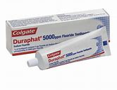
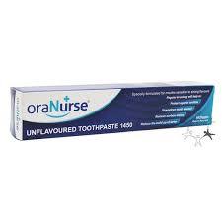
Toothpastes
Ideally use a pea sized amount of over the counter family fluoride toothpaste containing the fluoride content between 1350-1500 parts per million fluoride (ppm)
If a person has been prescribed a high fluoride toothpaste e.g. Duraphat 2500-5000 ppm by their dentist this should be used instead of a regular toothpaste
A low foaming , flavour free/no taste, toothpaste e.g. OraNurse, can be more comfortable to use for a person with a sore mouth and/or swallowing difficulties or those with sensory issues
Notes:
Ideally use a pea sized amount of over the counter family fluoride toothpaste containing the fluoride content between 1350-1500 parts per million fluoride (ppm)
If a person has been prescribed a high fluoride toothpaste by their dentist, for example Durpahat 2500-5000 ppm this should be used instead of a regular toothpaste
A low foaming, flavour and taste free, toothpaste such as OraNurse, can be more comfortable to use for a person with a sore mouth or swallowing difficulties, or for those with sensory issues

Slide 7
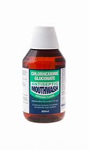
Mouthwashes
If a person has requested the use of their own mouthwash as part of their mouth care plan, this must be used at a different time to toothbrushing to maximise the topical fluoride effect from the toothpaste
If gums bleed when brushed this could be a sign of gum disease. Chlorhexidine gluconate products can help as a short-term treatment (1-2 weeks). Side effects can include staining of teeth, dentures (remove dentures before use) and tongue, and impaired taste
An individual may have been prescribed a fluoride mouth rinse by their dentist. This must be used at a different time to toothbrushing to maximise the topical fluoride effect
Notes:
If a person has requested the use of their own mouthwash as part of their mouth care plan, this must be used at a different time to toothbrushing to maximise the topical fluoride effect from the toothpaste
If gums bleed when brushed this could be a sign of gum disease. Chlorhexidine gluconate products such as Corsodyl can help as a short-term treatment, use about 1-2 weeks. Side effects can include staining of teeth, dentures (remove dentures before use) and tongue, and impaired taste
An individual may have been prescribed a fluoride mouth rinse by their dentist. This again should be used at a different time to toothbrushing to maximise the topical fluoride effect of toothpaste.

Slide 8
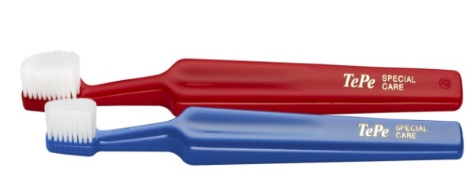
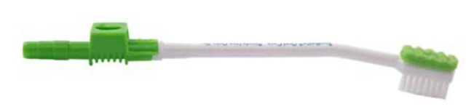
Toothbrushes
and adaptions
Use either a manual or a powered toothbrush with a small head and medium-texture bristles (individual’s own preference)
Toothbrush handles can be adapted to improve the grip especially useful with limited manual dexterity
If a person has a sore or fragile mouth perhaps because of a dry mouth, medical condition, ulcer or receiving palliative care, consider using a very small soft textured toothbrush e.g. Tepe Special care toothbrush
Suction toothbrushes – Useful for clients at risk of aspiration. Attach onto suction to assist in removal of secretions. Individually wrapped, single use item
Notes:
Use either a manual or a powered toothbrush with a small head and medium-texture bristles, try to accommodatean individual’s own preference.
Toothbrush handles can be adapted to improve the grip, this is especially useful with a limited manual dexterity, for example after a stroke. You can add foam grips, bicycle handle grips or putty set to the persons hand impression.
If a person has a sore or fragile mouth perhaps because of a dry mouth, medical conditions, ulcers or receiving palliative care, consider using a very small soft textured toothbrush for example Tepe Special care toothbrush
Suction toothbrushes are Useful for clients at risk of aspiration. They attach onto suction to assist in removal of secretions while the teeth are brushed. They individually wrapped and a single use item

Slide 9
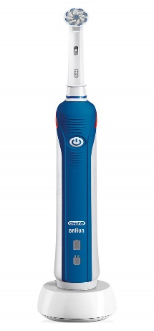
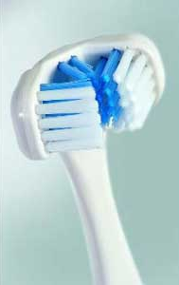
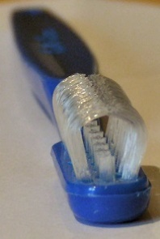

Electric toothbrush
An electric toothbrush can be used if this is the individual’s preference, it is good practice to seek advice from a dental professional
Multi-headed toothbrush
Special toothbrushes such as Dr Barman’s or Collis curve toothbrush clean multiple surfaces at once and are useful for individuals with limited manual dexterity or for those where brushing maybe an issue
Oralieve 360 toothbrush
This brush has 360⁰ bristles to clean multiple surfaces of the mouth simultaneously. A small head to get to hard to reach areas of the mouth
Soft bristles to provide a gentle clean to sore or sensitive mouths
An easy-to-grip handle
Notes:
Electric toothbrush
An electric toothbrush can be used if this is the individual’s preference, they naturally have a wide handle and are easy to use. Some people with sensory issues accommodate these well, others not so. it is good practice to seek advice from a dental professional
Multi-headed toothbrushes
Theses are special toothbrushes for example Dr Barman’s or Collis curve and clean multiple surfaces at once and are useful for individuals with limited manual dexterity or for those where brushing maybe an issue.
The Oralieve 360 toothbrush
Has 360⁰ bristles all around the head to clean multiple surfaces of the mouth simultaneously
It has a small head to get to hard to reach areas of the mouth
Soft bristles to provide a gentle clean to sore or sensitive mouths both to the teeth and soft tissues and it has an easy-to-grip handle

Slide 10
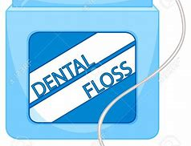
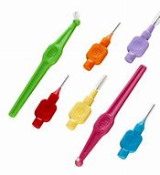
Interdental Products
Cleaning in between the teeth may be possible if this is part of a person’s oral hygiene routine but may not be possible for all individuals to do
Interdental brushes are ideal and come in a variety of sizes
Bottle brushes, interdental brushes and dental floss should be used with care
Always seek guidance from a dental care professional
Notes:
Cleaning in between the teeth may be possible if this is part of a person’s oral hygiene routine but may not not be possible for all individuals to do
Interdental brushes and bottle brushes are ideal and come in a variety of sizes.
Bottle brushes, interdental brushes and dental floss may be used but care and guidance from a dental care professional can be useful

Slide 11
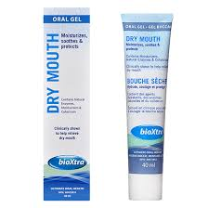
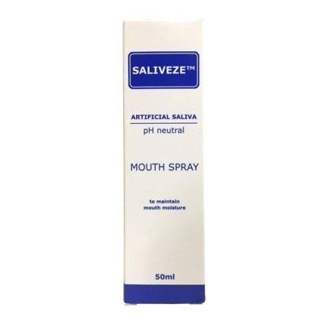
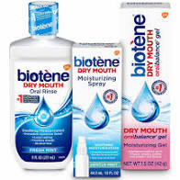
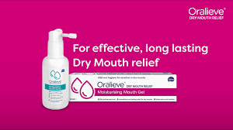
Oralieve
BioXtra
Saliveze
Biotene
Many medications cause a dry mouth which can be very uncomfortable
Dry Mouth Gels and sprays – over the counter
Different products available with the purpose to relieve the symptoms of dry mouth. They are not an alternative to brushing teeth with toothpaste. Dry mouth gels should be massaged into the soft tissues of the mouth (tongue, cheeks and lips) using either a toothbrush, MouthEze oral cleanser or a gloved finger (if safe to do so). They can also be used to soften dried oral secretions and help with the retention of a denture. The gels shown here is not exhaustive
Products to help with dry mouth (over the counter)
Notes:
Dry Mouth Gels and sprays – over the counter
Many medications cause a dry mouth which can be very uncomfortable
There are many different products available with the purpose to relieve the symptoms of dry mouth. They are not an alternative to brushing teeth with toothpaste. They help make the soft tissues moist and put a protective layer over the tissues. They are especially useful at nighttime and in end of life care. Dry mouth gels should be massaged into the soft tissues of the mouth (tongue, cheeks and lips) using either a toothbrush, MouthEze oral cleanser or a gloved finger (if safe to do so). They can also be used to soften dried oral secretions and help with the retention of a denture. The list of gels shown here is not exhaustive.

Slide 12
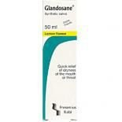
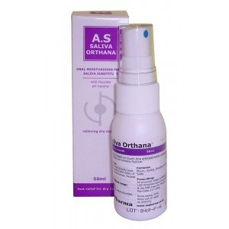
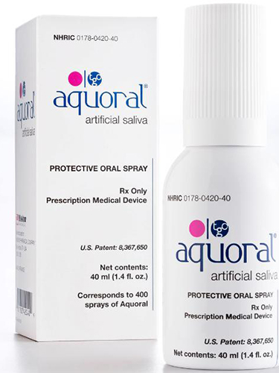
Products to help with dry mouth cont’d
Artificial Saliva spray – (prescription only)
These are sprayed onto the inside of the cheeks, tongue and palate. Form a protective layer over soft tissues
Glandosane - has a low pH and should not be used for people with natural teeth
Saliva Orthana – pH neutral. Contains mucin (animal based) Not suitable for vegetarians or vegans
Aquoral oral spray will help with symptoms but can also help heal and restore damage done to the mouth and mucous membranes
Notes:
Artificial Saliva spray – (prescription only)
These are sprayed onto the inside of the cheeks, tongue and palate, and form a protective layer over soft tissues. These are especially useful at nighttime and in end of life care. Seek advise from a speech and language therapist if there are concerns of aspiration
Glandosane - has a low pH (so is acidic) and should not be used for people with natural teeth.
Saliva Orthana – pH neutral. Contains mucin which is animal based. This is not suitable for vegetarians or vegans
Aquoral oral spray will help with symptoms of a dry mouth but can also help heal and restore damage done to the mouth and mucous membranes

Slide 13
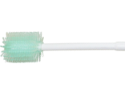
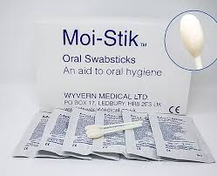
Oral Cleansers
MouthEze oral cleanser - is designed to clean soft tissues NOT to brush teeth. Can be used to remove dry or sticky secretions from all areas of the mouth. Useful when used with dry mouth gel or spray
Moi-Sticks – Premoistened swabstick with saliva replacement spray. Solution is colourless, has neutral pH and mild mint flavour. Use to cleanse and moisten all intraoral surfaces (useful in end of life care)
Notes:
A MouthEze oral cleanser - is designed to clean soft tissues NOT to brush teeth. It has soft plastic bristles which gently brush the the tissues of the mouth. They can be used to remove dry or sticky secretions from all areas of the mouth and is especially useful when used with a dry mouth gel or spray
Moi-Sticks – a Premoistened swabstick with saliva replacement spray. The solution is colourless, has neutral pH and mild mint flavour. Use to cleanse and moisten all intraoral surfaces and are useful in end of life care.

Slide 14
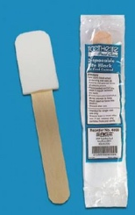
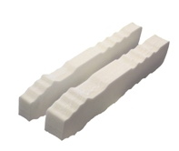
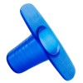
Mouth Props
Bite blocks/mouth prop – soft foam block for gently propping mouth open to allow access for toothbrushing
Finger guard – Hard plastic block for client to bite onto. Allows access for toothbrushing
May need two people
Notes:
Mouth props – These are useful to use in clients that bite down onto the toothbrush or those that find it hard to keep the mouth open
Bite blocks/ or mouth prop are made with a soft foam block for gently propping mouth open to allow access for toothbrushing
Finger guard – Hard plastic cover for client to bite onto and again allows access for toothbrushing
It may take two people to use these, one to hold the prop and one to brush the teeth.

Slide 15
Summary
All individuals must have access to the oral health products they require for good daily mouth care
With permission, it is good practice to engage with carers, family and friends who may wish to be involved with all aspects of mouth care
Ensure individual needs and preferences are assessed and recorded in their mouth care plan and includes anything prescribed by their dentist or doctor
Always seek the advice of a dental care professional
Notes:
To summarise this section:
All individuals must have access to the oral health products they require for good daily mouth care
With permission, it is good practice to engage with carers, family and friends who may wish to be involved with all aspects of mouth care
Ensure individual needs and preferences are assessed and recorded in their mouth care plan and includes anything prescribed by their dentist or doctor
Always seek the advice of a dental care professional for guidance with oral care products.

