Slide 1
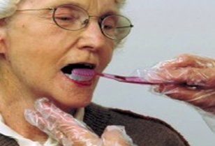
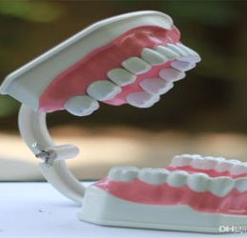

Mouth Care Matters in the Community
Mouth care training for staff in the community
SECTION 2
Notes:
Welcome to section 2 of the e-learning package Mouth Care Matters in the Community. – Mouth care training for staff in the community
In this section we will look at local guidance and tools used in your area, mental capacity and consent and infection control. We will also cover mouth care assessment and care plans, daily record keeping and how to support individual mouth care.

Slide 2



This slide set has been produced by the following partner organisations for use within the North West Region
Disclaimer
The authors take no responsibility for any actions undertaken when following this guidance. Health and Social Care professionals should only carry out procedures that they are trained in and that are within their competencies.
Mouth Care Matters - SECTION 2
Editor(s) | Health Education England – Queries /comments should be emailed to DWT@nhs.net
Contributors | Lesley Gough, Lynne Smith, Vicky Brand, Sue Hodgkiss, Helen Parsley and Emma Stonier
Version | 2
Issue date | October 2020
1st Review Next Review | October 2023 October 2025
Notes:
This slide set had been produced by the partners shown below for use within the North West Region

Slide 3



Learning outcomes
Participant will gain an increased knowledge and understanding of:
local guidance and tools to support mouth care
consent and the Mental Capacity Act
adopting a mouth care policy for the setting
the importance of PPE when providing mouth care
supporting mouth care for others
oral health risk assessments and care plans
using daily mouth care record sheets
Notes:
Learning Outcomes
The participant will gain an increased knowledge and understanding of:
local guidance and tools to support mouth care
consent and the Mental Capacity Act
adopting a mouth care policy for the setting
the importance of PPE when providing mouth care
supporting mouth care for others
oral health risk assessments and care plans
using daily mouth care record sheets

Slide 4

Local Guidance and Tools
Guidance and Tools
Mouth Care Policy
Mouth care assessments / individual care plan and daily log sheets
Level of support prompt sheet
Audit and assessment sheets
Dental care products
Resources and contacts
Notes:
Local Guidance and Tools
Your area will have it’s own guidance and toolkit. Below are examples from Cheshire & Merseyside and Greater Manchester.
These guides contain:–
A mouth care policy example and information on how to construct a policy for your setting
Mouth care assessments, individual care plans and daily log sheets
Level of support prompt sheets
Audit and assessment sheets
Advise regarding dental care products
And Resources and contacts and how to access dental care for your clients
To gain a copy of these, please contact your local oral health improvement team

Slide 5

Consent and Mental Capacity Act 2005
Important to obtain consent before supporting client with their oral hygiene
To be able to give consent, person needs to be able to:
  - Understand what you propose to do
  - Able to understand the benefits of having it/not having done
  - Able to retain information long enough to make decision
  - Able to communicate their decision
Where client lacks capacity to give consent, decision is taken under ‘best interest’ principles of Mental Capacity Act 2005
Important to try and develop clients’ ability to consent before assuming ‘best interest’ decision. This can be achieved by working with client and their key workers
Also use accessible information (e.g., easy read leaflets, words and pictures)
Always document reasons if ‘best interest’ decision is needed
Notes:
It is important to obtain consent before supporting a client with their oral hygiene
To be able to give consent, person needs to be able to:
Understand what you propose to do
Understand the benefits of having or not having mouth care carried out
Able to retain information long enough to make decision
Communicate their decision
Where the client lacks capacity to give consent, the decision is taken under ‘best interest’ principles of Mental Capacity Act 2005
It is always important to try and develop the clients’ ability to consent before assuming ‘best interest’ decision. This can be achieved by working with the client and their key workers or those who understand how best to communicate information to them
Also use accessible information (e.g. easy read leaflets, words and pictures), to keep client as informed and involved as much as possible
Always document reasons if ‘best interest’ decision is needed along with the people who have been consulted or involved

Slide 6
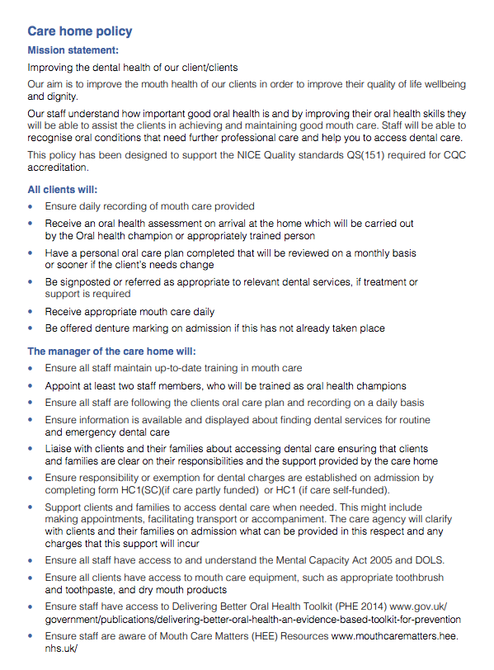
Mouth Care Policy
CQC expect registered managers to take account of nationally recognised guidance
Include evidence to show how clients are supported to maintain good oral health
Mouth Care Policy should include:
a policy statement
outline what the service will offer from care staff and managers
give a summary of care
give advice on staff training
Example
Notes:
We will now look at the policies and documents required to meet the standards outlined the CQC.
Mouth care policy
The CQC expect registered managers to take account of nationally recognised guidance
Your mouth care policy should include evidence to show how clients are supported to maintain good oral health
A Mouth Care Policy should include
A Policy statement
An outline of what the service will offer from care staff and managers
Give a summary of care
Give advise on staff training
An example and guidance for a mouth care policy can be found in your local toolkit

Slide 7
Importance of Personal Protective Equipment (PPE)
When providing mouth care for residents/clients, PPE must be worn to prevent contact and droplet transmission.
Delivering mouth care is not an aerosol generating procedure, so PPE includes:
  Disposable gloves
  Plastic apron
  Fluid resistant masks
  Eye protection/visor
Some clients/residents may require use of enhanced PPE e.g., ventilated clients:
  Eye protection/visor
  FFP3 Respirator mask
  Long-sleeved disposable gown
  Gloves
  Apron

Slide 8
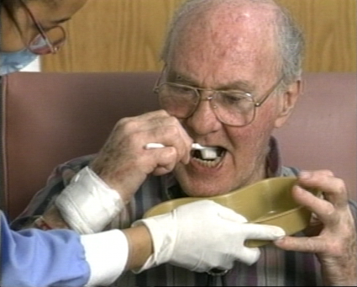

Level of support
Independent
Can get to a sink with no assistance, gather mouth care equipment, apply toothpaste, complete mouth care without intervention
Some Assistance
Unable to get to sink or needs help with mouth care, i.e., needs bowl, encouragement, reminder, help to remove dentures etc.
Fully dependent
Unable to carry out mouth care on their own due to dementia, stroke, end of life care
Record any help given on daily log sheet
Prompt, encourage and support
Notes:
When assessing a client for mouth care, we need to consider the level of support they may require.
The client could be fully Independent – they can get to the bathroom or sink, gather the correct mouth care equipment and brush their teeth/clean dentures with no help needed. This should be recorded on daily log sheet
Or they may require some assistance – May just need reminding to do brush teeth or encouragement to do all areas. They may need a bowl bringing to them or help to remove and clean dentures
Or they maybe fully dependent on carers for their personal care – This could be due to many reasons such as dementia. Stroke or disability or if the client requires end of life care.
Record any help given to the client or if they refuse mouth care
Always remember to Prompt, encourage and support the client.

Slide 9
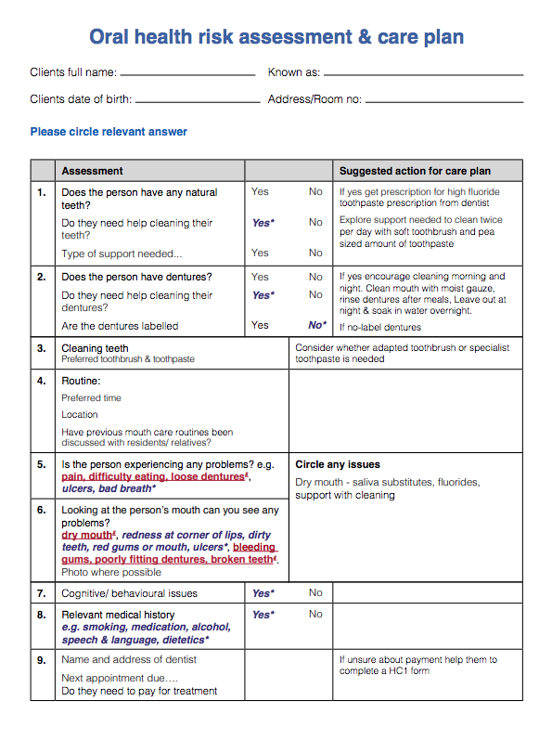
Oral Health Risk Assessment & Care Plan
Example
Should be completed as soon as possible after accepting a client for care, (ideally within 24 hours) The document will become part of clients’ personal care plan.
Records condition of: -
Lips
Tongue
Teeth & gums
If dentures are present and if they are labelled
Type of mouth care equipment used/preferred
Notes:
The next document we will look at is the Oral Health risk assessment and care plan
This should be completed as soon as possible after accepting a client for care (ideally within 24hrs ) and this document will become part of clients’ personal care plan. This should be completed by an appropriately trained team member
A mouth care assessment is not a dental examination or a diagnostic tool. A mouth care assessment is designed to inform of an individual’s mouth care plan only. Any concerns regarding the mouth should be recorded and escalated to a medial or dental professional.
All people irrespective of whether they have any natural teeth or not should visit a dentist for a routine dental check-up at least once a year.
In this example of a mouth care assessment, an item in blue italics requires additional care from carers, or an item in red italics requires direction form a doctor or dentist
The oral health risk assessment records condition of: -
Lips
Tongue
Teeth & gums
If dentures are present and if they are labelled
Type of mouth care equipment used or preferred

Slide 10
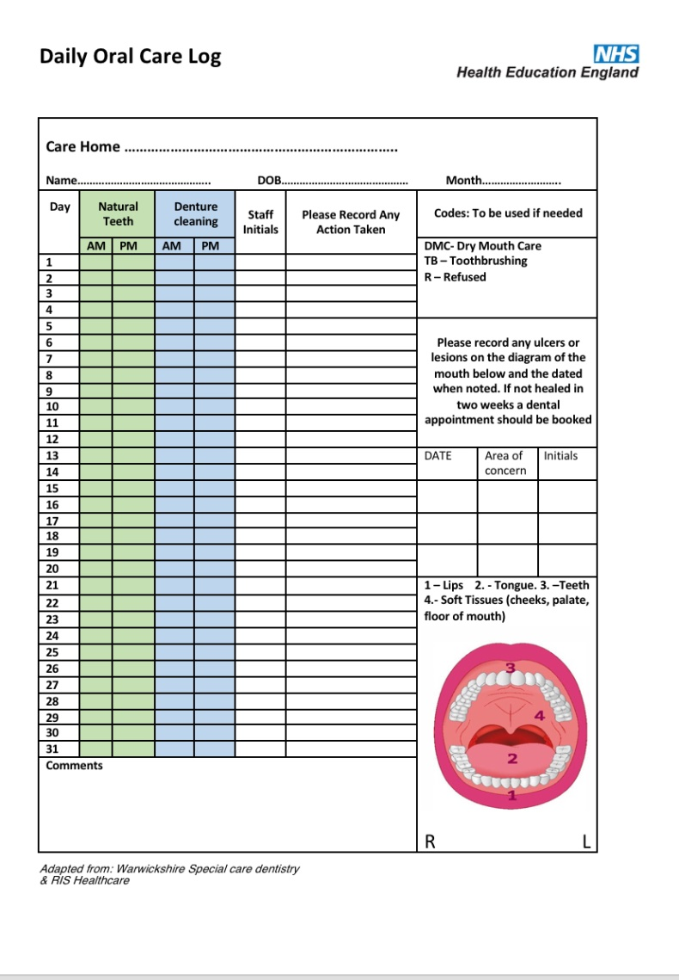
Daily recording sheet
Completed when:
toothbrushing is carried/attempted
natural teeth and dentures are cleaned
Contains mouth map to record any lesions or ulcers in the mouth
Codes can be used to aid completion:-
  TB – Toothbrushing
  DMC - Dry Mouth Care
  R – Refused
If a resident refuses mouth care:-
Document
Try at a later time
Try different coping strategies
Example
Notes:
A daily recording sheet or log should also be part of the clients personal care plan. This is a simple tick sheet that is completed every time mouth care is carried out or attempted. In this example the green section is for natural teeth, the blue for dentures.
It also contains a picture of mouth or mouth map. This is used in a similar way a body map is used to record pressure ulcers.
If you notice any soreness, ulcers or a graze in the mouth, record on the mouth map with an X and date the entry. Usually an ulcer or graze that appears in the mouth will heal and repair within 2-3 weeks. If the lesion is still present after this time, this should be escalated to a dental professional or doctor for advice.
There is also an example of codes that can be used to aid quicker completion, TB-toothbushing, DMC – dry mouth care given, R – refused.
If a client refuses mouth care, document this on the sheet and try at a later time or try different coping statergies (these are covered in other sections).

Slide 11

How do YOU feel when…
When you are away for a night(s) and forget your toothbrush?
When you are busy working and have no time to have a drink?
When you have a painful
mouth ulcer?
When you have to kiss someone with bad breath?

Slide 12
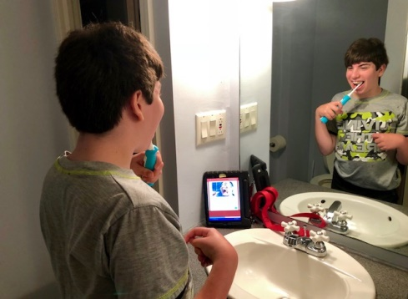
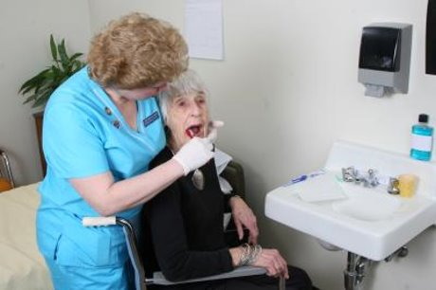
Supporting Individual Mouth Care
Cleaning someone else’s teeth can be difficult but giving them the dignity and respect of having a clean, comfortable mouth makes it worthwhile.
Promote self-care as much as possible
Some people may need just encouragement or reminders to brush their teeth
Others may need some assistance or may be fully dependent on carers for mouth care
The following sections with explain techniques, equipment and skills to help support mouth care
Notes:
Cleaning someone else’s teeth can be difficult but giving them the dignity and respect of having a clean, comfortable mouth makes it worthwhile.
Try and promote self-care as much as possible
Some people may need just encouragement or reminders to brush their teeth
Others may need some assistance or may be fully dependent on carers for mouth care
The following sections with explain techniques, equipment and skills to help support mouth care

Slide 13
Summary
Your area will have its own local guidance and toolkit to support mouth care. A copy can be obtained via your Oral Health Improvement team
Consent must be obtained before supporting a client with mouth care. Where client lacks capacity a best interest decision is taken working with the principles of the Mental Capacity Act 2005
A Mouth Care Policy should be in place for each service and should include; a policy statement, a summary of care and advice on staff training
Appropriate PPE should be worn when providing mouth care
An oral health risk assessment and care plan should be completed for all new clients
A daily mouth care record log should be completed as part of daily personal care
Notes:
To summerise this section:-
Your area will have its own local guidance and toolkit to support mouth care. A copy can be obtained via your Oral Health Improvement team
Consent must be obtained before supporting a client with mouth care. Where a client lacks capacity a best interest decision is taken working with the principles of the Mental Capacity Act 2005
A Mouth Care Policy should be in place for each service and should include; a policy statement, a summary of care and advice on staff training
Appropriate PPE should be worn when providing mouth care
An oral health risk assessment and care plan should be completed for all new clients
A daily mouth care record log should be completed as part of daily personal care

Slide 14

Assessment
What must be obtained before supporting a client with mouth care?
Answer:- Consent
What legislation is used if consent cannot be given?
Answer:- Mental Capacity Act 2005
Notes:
Now a short activity – consider the following:-
You have a new resident admitted to your setting, what would be the first thing you would do in terms of mouth care?
Answer :-
Complete mouth care assessment and care plan

