Slide 1
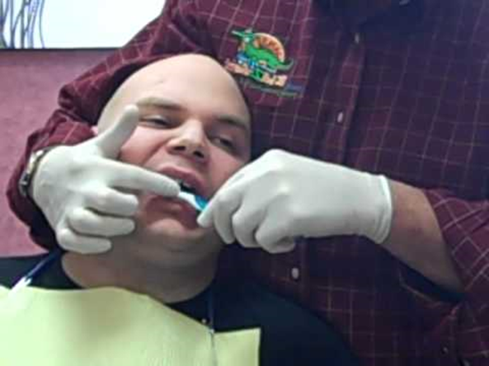
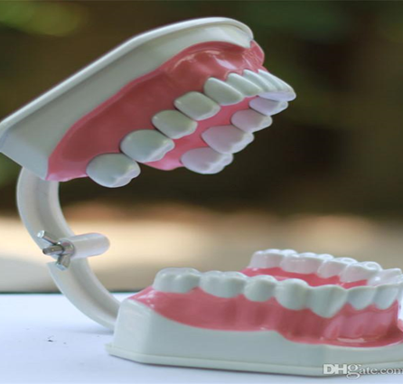
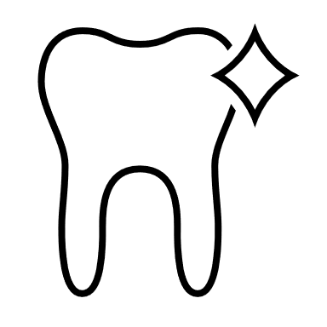

Mouth Care Matters in the Community
Training for staff in the community
Section 3
Personal mouth care for all
Notes:
Welcome to section 3 of the e-learning package Mouth Care Matters in the Community. – Personal mouth care for all
In this section we will cover the links between oral health and general health, look at the mouth care assessment tool and how to set up a personal care plan. We will also look at the different equipment available to help with mouth care.

Slide 2



This slide set has been produced by the following partner organisations for use within the Northwest Region
Disclaimer
The authors take no responsibility for any actions undertaken when following this guidance. Health and Social Care professionals should only carry out procedures that they are trained in and that are within their competencies.
Mouth Care Matters - SECTION 3
Editor(s) | Health Education England – Queries /comments should be emailed to DWT@nhs.net
Contributors | Lesley Gough, Lynne Smith, Vicky Brand, Sue Hodgkiss, Helen Parsley and Emma Stonier
Version | 2
Issue date | October 2020
1st Review Next Review | October 2023 October 2025
Notes:
This slide set had been produced by the partners shown below for use within the North West Region

Slide 3
Learning outcomes
The participants will gain an increased knowledge and understanding of
The links between oral health and general health
An assessment tool to be completed on admission and implement effective mouth care to address personal oral health needs
The importance of mouth care and the promotion of good effective oral hygiene
The different equipment available to help with mouth care
Notes:
Learning outcomes
The participants will gain an increased knowledge and understanding of
The links between oral health and general health
An assessment tool to be completed on admission and implement effective mouth care to address personal oral health needs
The importance of mouth care and the promotion of good effective oral hygiene
The different equipment available to help with mouth care

Slide 4
Why bother with mouth care?
  Support for good oral and dental care is an essential part of promoting health and quality of life for vulnerable people and people with learning disabilities (Daly et al 2013)
  Good oral health enables people to communicate effectively
  Helps in ability to eat and enjoy a variety of foods
​
  Care providers are delivering more complex care for an increasing number of vulnerable and older people. These people are living longer and have complex health and social care needs.
  Due to improvements in dental health, an increasing number of vulnerable and older people are keeping their own teeth for longer and need more complex dental care.
Notes:
So, why do we bother with mouth care?
Research shows that support for good oral and dental care is an essential part of promoting health and quality of life for vulnerable people and people with learning disabilities (Daly et al 2013)
Good oral health enables people to communicate effectively
And helps in ability to eat and enjoy a variety of foods
Care providers are delivering more complex care for an increasing number of vulnerable and older people. These people are living longer and have complex health and social care needs.
Also due to the improvements in dental health, an increasing number of vulnerable and older people are keeping their own teeth for longer and these people may require more complex dental care.

Slide 5
A Healthy Mouth
The mouth is clean
The gums, tongue and cheeks are healthy not reddened or swollen
No broken fillings
Healthy Mouth
No tooth decay
Dentures are clean and fit well
Mouth that is moist with saliva
No pain
No mouth ulcers or undiagnosed red or white patches
Notes:
What constitutes a healthy mouth
A healthy mouth should should be clean – we need to brush every day to remove dental plaque (a mixture of bacteria and food)
The gums, tongue and cheeks are healthy not reddened or swollen – healthy gums fit tight around the teeth and don’t bleed. Good mouth care keeps all the mouth healthy
Any dentures present are clean and fit well – even if people have no natural teeth, dentures still need daily cleaning
The mouth that is moist with saliva – a lack of saliva causes the mouth to be dry. This can impact on the health of the mouth.
A healthy mouth will have no ulcers or undiagnosed red or white patches
A healthy mouth should cause no pain
Also there should be no active tooth decay or broken fillings

Slide 6
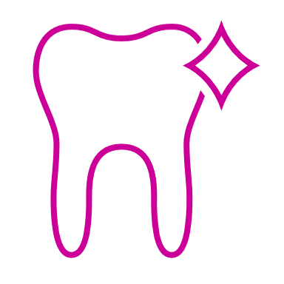
Good Oral Health
Good oral health is the absence of pain and disease with the ability to eat, drink and communicate which is important for quality of life
Good oral health is important for people’s dignity
Poor oral health can lead to dehydration and malnutrition for clients, resulting in poor health outcomes.
Notes:
Good oral health is the absence of pain and disease with the ability to eat, drink and communicate which is important for quality of life
Good oral health is important for people’s dignity
Poor oral health can lead to dehydration and malnutrition for clients’ resulting in poor health outcomes.

Slide 7
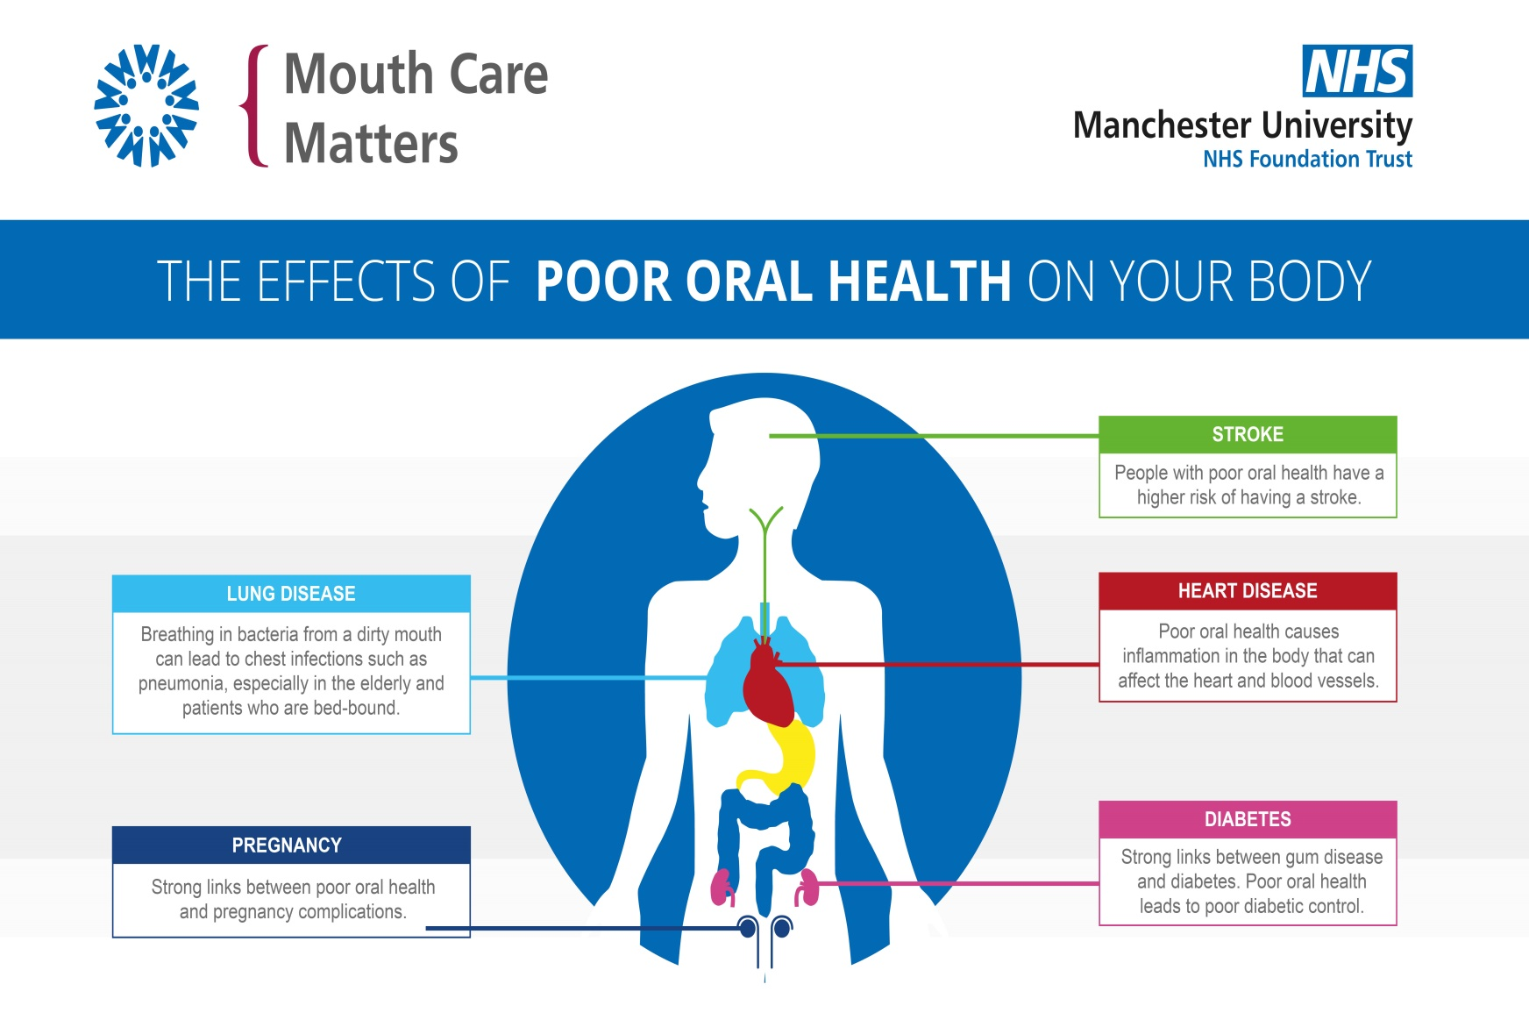
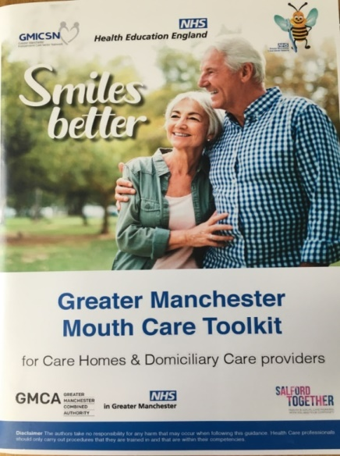

Slide 8

Whose role is mouth care?
Anybody who is looking after another’s personal needs
Notes:
So – Whose role is mouth care?
Anybody who is looking after another’s personal needs

Slide 9
Health Care Roles in mouth care and oral health may include:
Care Staff: Carrying out mouth care assessments, recording personal oral care needs and assisting or providing mouth care to meet those oral health needs
Doctors: Diagnosing and prescribing for oral conditions such as ulcers and oral thrush
Speech and language therapist (SaLT): Providing mouth care advice for high risk dysphagia patients
Dietetics team: Giving nutritional advice taking into account oral health
Occupational therapists (OT): Helping to advise and/or create aids for toothbrushes for patients with physical disabilities
Pharmacists: Advising patients/carers on drug related oral problems including dry mouth
Physiotherapists: This role can involve looking in the mouth and will make other teams aware of poor mouth conditions
Notes:
Health care roles in mouth care and oral health may include:-
Care Staff: Carrying out mouth care assessments, recording personal oral care needs and assisting or providing mouth care to meet those oral health needs
Doctors: When diagnosing and prescribing for oral conditions such as ulcers and oral thrush
Speech and language therapist (SaLT): Providing mouth care advice for high risk dysphagia patients. Theses are people with swallowing problems
Dietetics team: Giving nutritional advice taking into account oral health
Occupational therapists (OT): Helping to advise or create aids for toothbrushes for patients with physical disabilities
Pharmacists: Advising patients and carers on drug related oral problems including dry mouth
Physiotherapists: This role can involve looking in the mouth and will make other teams aware of poor mouth conditions

Slide 10
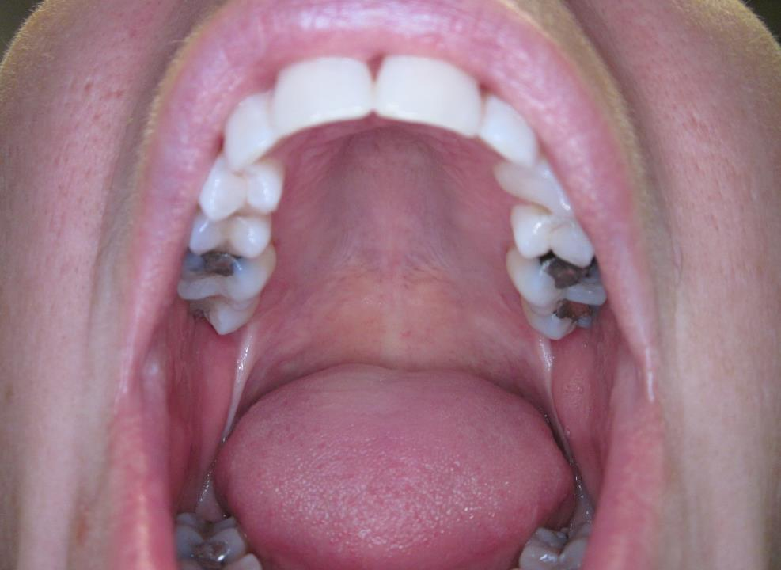
How to carry out an oral health assessment
Notes:
Next we will look at how to carry out a mouth care assessment. The documents shown on the next slides are examples, your area may have others that can be used

Slide 11
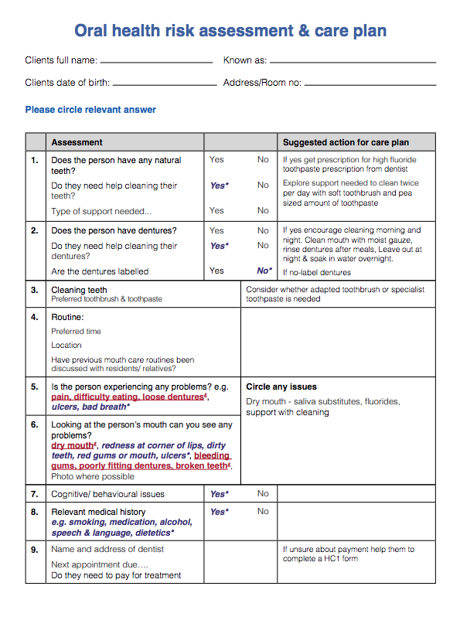
Oral Health Risk Assessment & Care Plan
Should be completed as soon as possible after accepting a client for care, (ideally within 24 hours) The document will become part of clients’ personal care plan.
Records condition of: -
Lips
Tongue
Teeth & gums
If dentures are present and if they are labelled
Type of mouth care equipment used/preferred
Example
Notes:
The next document we will look at is the Oral Health risk assessment and care plan
This should be completed as soon as possible after accepting a client for care (ideally within 24hrs ) and this document will become part of clients’ personal care plan. This should be completed by an appropriately trained team member
A mouth care assessment is not a dental examination or a diagnostic tool. A mouth care assessment is designed to inform of an individual’s mouth care plan only. Any concerns regarding the mouth should be recorded and escalated to a medial or dental professional.
All people irrespective of whether they have any natural teeth or not should visit a dentist for a routine dental check-up at least once a year.
In this example of a mouth care assessment, an item in blue italics requires additional care from carers, or an item in red italics requires direction form a doctor or dentist
The oral health risk assessment records condition of: -
Lips
Tongue
Teeth & gums
If dentures are present and if they are labelled
Type of mouth care equipment used or preferred

Slide 12
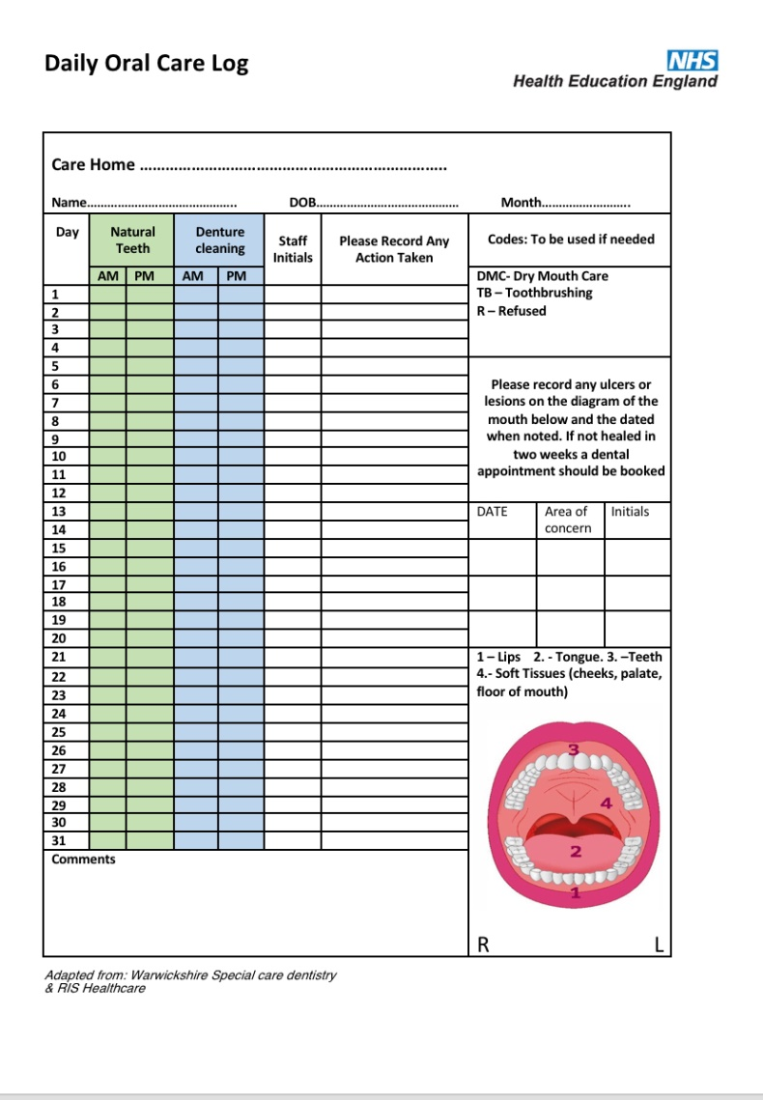
Daily recording sheet
Example
Completed when:
toothbrushing is carried/attempted
natural teeth and dentures are cleaned
Contains mouth map to record any lesions or ulcers in the mouth
Codes can be used to aid completion:-
  TB – Toothbrushing
  DMC - Dry Mouth Care
  R – Refused
If a resident refuses mouth care:-
Document
Try at a later time
Try different coping strategies
Notes:
A daily recording sheet or log should also be part of the clients personal care plan. This is a simple tick sheet that is completed every time mouth care is carried out or attempted. In this example the green section is for natural teeth, the blue for dentures.
It also contains a picture of mouth or mouth map. This is used in a similar way a body map is used to record pressure ulcers.
If you notice any soreness, ulcers or a graze in the mouth, record on the mouth map with an X and date the entry. Usually an ulcer or graze that appears in the mouth will heal and repair within 2-3 weeks. If the lesion is still present after this time, this should be escalated to a dental professional or doctor for advice.
There is also an example of codes that can be used to aid quicker completion, TB-toothbushing, DMC – dry mouth care given, R – refused.
If a client refuses mouth care, document this on the sheet and try at a later time or try different coping statergies (these are covered in other sections).

Slide 13
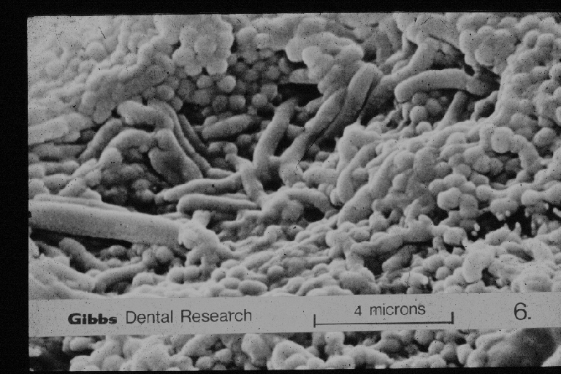
Why should we brush teeth and gums?
To remove the sticky film of plaque bacteria which forms on everybody's teeth and gums
This will minimise the risk of gum disease
To minimise the risk of aspiration pneumonia if an individual is tube fed or has a poor swallow reflex
To add fluoride to the teeth to help control tooth decay/root caries
Plaque bacteria under a microscope
Notes:
Why should we brush teeth and gums?
We brush our teeth to remove the sticky film of plaque bacteria which forms on everybody's teeth and gums. This bacteria sits at the gum margin and the body’s defence system has to fight to prevent harmful bacteria from penetrating at this junction. If it is affected the body’s reaction is inflammation and bleeding – This is the the first stage of gum disease, known as Gingivitis
Brushing will minimise the risk of gum disease
Brushing also minimises the risk of chest infections and aspiration pneumonia especially if an individual is tube fed or has a poor swallow reflex
Brushing also adds fluoride to the teeth to help control tooth decay/root caries
Fluoride will help to protect teeth but the teeth will still decay if Sugar is given too frequently throughout the day and or night.
Brushing also freshens the mouth and improves oral health

Slide 14
Importance of Personal Protective Equipment (PPE)
When providing mouth care for residents/clients, PPE must be worn to prevent contact and droplet transmission.
Delivering mouth care is not an aerosol generating procedure, so PPE includes:
  Disposable gloves
  Plastic apron
  Fluid resistant masks
  Eye protection/visor
Some clients/residents may require use of enhanced PPE e.g. ventilated clients:
  Eye protection/visor
  FFP3 Respirator mask
  Long-sleeved disposable gown
  Gloves
  Apron

Slide 15
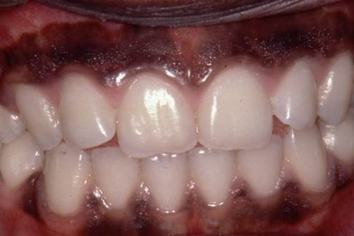
Gum disease (gingivitis, periodontitis)
Gum disease causes inflammation and bleeding of the gums. This can then lead to the breakdown of bone around the teeth and eventual tooth loss.
A healthy mouth.
Gums fit tightly around the teeth and are not swollen. Healthy gums don’t bleed when brushed
Unhealthy mouth
Plaque (germs/bacteria) collected around gumline
Gums look red, swollen/puffy and would bleed easily when brushed
Notes:
Gum disease causes inflammation and bleeding of the gums. This can then lead to the breakdown of bone around the teeth and eventual tooth loss.
A healthy mouth.
If we look at this picture, we see the gums fit tightly around the teeth and are not swollen. Healthy gums don’t bleed when brushed
Unhealthy mouth
In this picture we can see plaque collected around gumline
The gums look red, swollen/puffy and would bleed easily when brushed

Slide 16
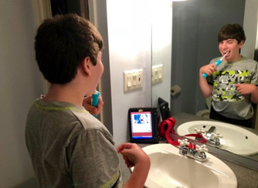
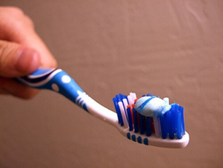
Preventing gum disease
Brush twice a day with a pea size amount of fluoride toothpaste
Use a small headed toothbrush or a powered toothbrush. Powered toothbrushes should not be used if Covid 19 is suspected.
Promote self-care as much as possible
Brush at night and one other time of the day
Spit out toothpaste but don’t rinse
A high fluoride toothpaste can be prescribed by a dentist
Notes:
Brush twice a day with a pea size amount of fluoride toothpaste
Use a small headed toothbrush or a powered toothbrush. Powered toothbrushes should not be used if Covid 19 is suspected.
Brush at night and one other time of the day
Spit out toothpaste but don’t rinse - This allows the fluoride from the toothpaste to stay in the mouth longer and helps strengthen the teeth and repair any early tooth decay
A high fluoride toothpaste can be prescribed by a dentist

Slide 17
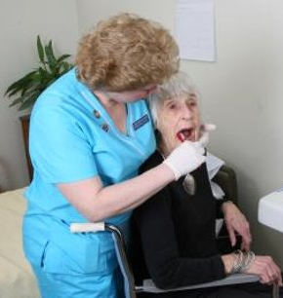
Supporting others
Some people may need just encouragement or reminders to brush their teeth
Others may need some assistance or may be fully dependent on carers for mouth care
Notes:
Supporting others with mouth care
Some people may need just encouragement or reminders to brush their teeth
Others may need some assistance or may be fully dependent on carers for mouth care

Slide 18
Brushing someone’s teeth
Wear PPE in accordance with infection prevention & control guidance
Approach at eye level, smile and explain what you are going to do
Check lips for dryness/cracking. Apply lip balm before mouth care
Remove any dentures and clean separately
If person is able, encourage them to brush their own teeth. Help may be needed to reach all areas.
If they can’t brush, make sure that the person is seated comfortably with their head supported, (on to your body or by another person)
Clients’ may cough when performing mouth care, be gentle, stand to side or behind client, take breaks to allow the client to rest and swallow
Notes:
The next slide gives some tips that may help if you have to brush someone elses teeth:-
Wear PPE in accordance with infection prevention & control guidance
Approach at eye level, smile and explain what you are going to do
Check lips for dryness/cracking. – if lips are dry and cracked, it is painful when they are stretched to brush teeth - Apply lip balm before mouth care
Remove any dentures and clean separately
If the person is able, encourage them to brush their own teeth. Help may be needed to reach all areas.
If they can’t brush, make sure that the person is seated comfortably with their head supported, (on to your body or by another person)
Clients’ may cough when performing mouth care, be gentle, stand to the side or behind client , take breaks to allow the client to rest and swallow

Slide 19
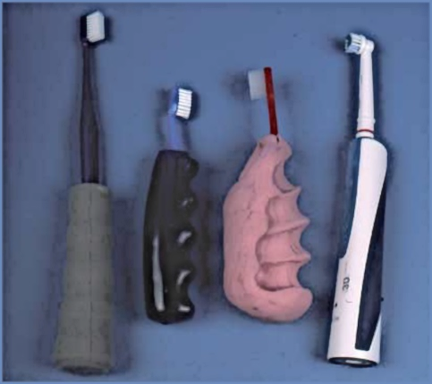
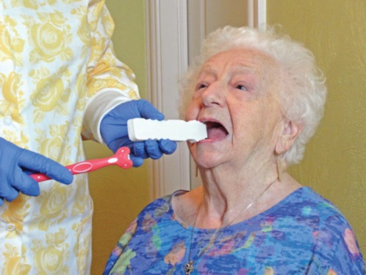
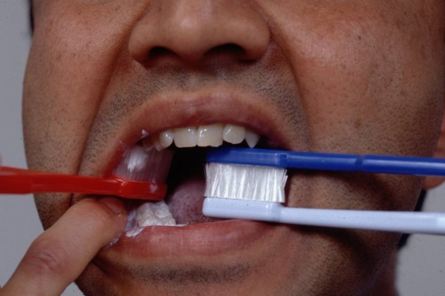
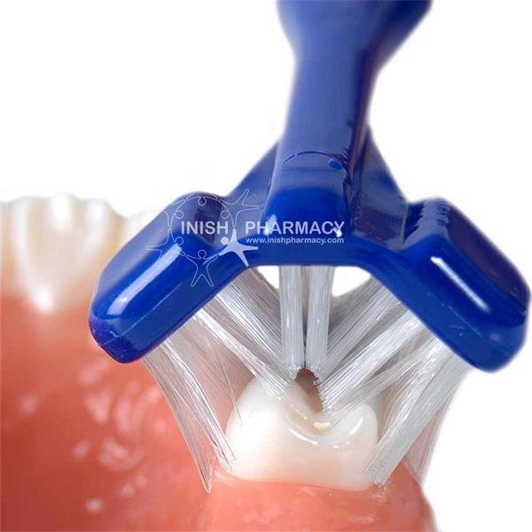
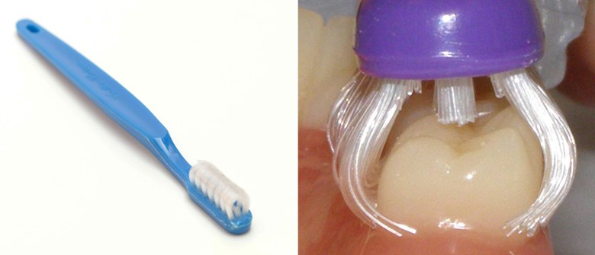
Brushing someone’s teeth cont’d…
Brushing someone’s teeth cont’d
Massaging the cheeks will encourage mouth opening
Brush all surfaces of upper and lower teeth beside the tongue, cheek and palate.
Encourage person to spit out toothpaste but don’t rinse
An electric toothbrush may be easier to use, (sometimes especially with sensory issues).
A brush with an adapted handle or multi-surface brush may also be helpful.
A mouth prop or 2 toothbrushes together, may help.
Notes:
Massaging the cheeks will encourage mouth opening- This gives a cue especially to clients with dementia or a learning disability that mouth care will happen
Brush all surfaces of upper and lower teeth beside the tongue, cheek and palate.
Encourage person to spit out toothpaste but don’t rinse
An electric toothbrush may be easier to use, (some people with sensory issues tolerate these well, others will not be able to accept the vibrations).
A brush with an adapted handle or multi-surface brush may also be helpful. The adapted handles make the width of the handle thicker and easier to use if someone has reduced manual dexterity. The multi-surfaces brushes, brush all the surfaces of the teeth at the same time. These are especially useful if you have limited time to brush, for example someone with dementia or a learning disability
A mouth prop or 2 toothbrushes together, may also help if the client tends to close onto the toothbrush. The mouth prop is placed in at the side of the mouth, keeping the mouth slightly open and allowing toothbrushing on the opposite side to the prop. It is then put on the other side of the mouth and toothbrushing carried out, again opposite the prop

Slide 20

Mouth care for clients with challenging behaviour
Calm and kind approach, maintain eye contact
Ask family or carer for assistance
Try different times of day, different areas
During a shower, watching TV
Short bursts
Desensitization techniques
Familiar toothpaste/toothbrush
Oral sensitivity, consider flavourless/non-foaming toothpaste
Notes:
Mouth care for clients with challenging behaviour – this is a problem many carers encounter, and the following tips may help
Maintain a calm and kind approach, maintain eye contact (if appropriate)
Ask family or carer for assistance – sometimes it will take 2 people to help, to support the head or hold hands
Try different times of day, different areas – some people are more compliant at different times of the day and distraction such as watching TV or during a shower may help
Brush in Short bursts – you may only get to brush one area at a time – record the area brushed onto daily log sheet
Desensitization techniques – these can help to build-up to brushing, it may take a few attempts of each stage the be accepted.
Start by stroking the cheeks and around the mouth, then brush the toothbrush over the back of the hand and work towards the lips. Place a smear of toothpaste onto the lip, brush one area and build up to brushing more areas
Always use a familiar toothpaste and toothbrush – see clients care plan for details
Some clients may have oral sensitivity, where strong flavours are not tolerated. Consider using flavourless/non- foaming toothpaste such as OroNurse. This still contains fluoride to help strength teeth

Slide 21
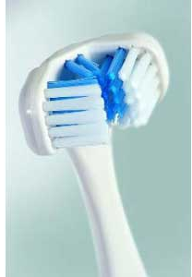
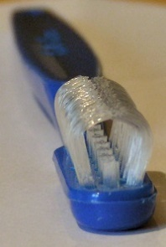
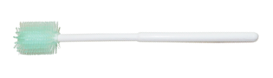
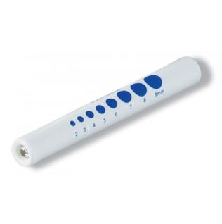
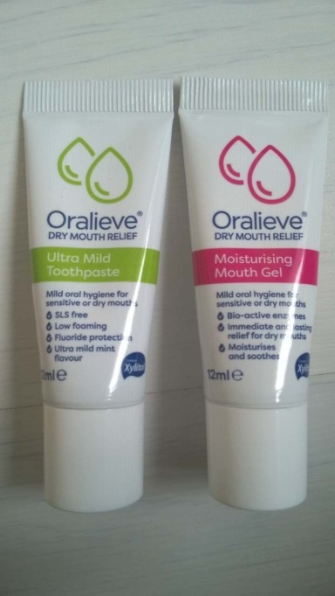
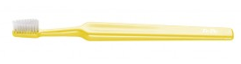

Mouth Care Products
Multi headed toothbrushes
Moutheze sticks
Pen torch
Dry Mouth Gel and toothpaste
Small headed toothbrush
Notes:
Mouth care products
The following products will help with mouth care. Information on where they can be purchased is in the dental products section of this e-learning package
Pen torch – the mouth is a dark place and they are very helpful when completing mouth care assessments
A small headed toothbush with soft or medium bristles is easier to use around the mouth. The Oralieve 360 toothbrush is also good to use
Dry Mouth Gels and toothpaste can help relieve dry mouth symptoms
Moutheze sticks – these are plastic cleaners for soft tissues. The soft plastic bristles help clean soft-tissues such as the tongue or cheeks. They can also be used to apply dry mouth gels
Multi-headed toothbrushes such as the Dr Barmans or Colis curve toothbrush, brush all 3 surfaces of the tooth at once. Ideal to use if you have to complete brushing quickly

Slide 22
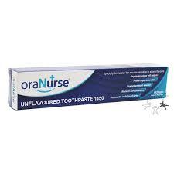
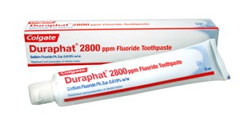
Specialist Products
Oranurse unflavoured toothpaste
Bite
Blocks
Sage Suction Toothbrush
Duraphat high fluoride toothpaste
Notes:
Specialist Products
Bite blocks or mouth prop – placed into mouth to prevent client closing onto the toothbrush
OroNurse toothpaste – this paste is flavourless and doesn’t foam in the mouth. It is ideal for clients who can’t tolerate strong flavours or may struggle with foam from toothpaste For example clients with swallowing difficulties
Suction toothbrushes – These toothbrushes have a suction tube connection and are excellent to remove any secretions during brushing. They have soft bristles on one side and a foam pad, to clean soft tissues on the other. Especially useful for with clients that have swallowing difficulties or are at risk of aspiration.
Duraphat high fluoride toothpaste - This has to be prescribed by the dentist and is double or triple the amount of a normal fluoride toothpaste – useful for clients at risk of tooth decay

Slide 23
SUMMARY
To summerise this section:-
Poor oral health has a major impact on general health and can put people at increased risks of heart disease, stroke and complications with diabetes. There is also an increased risk of chest infections and aspiration pneumonia if mouth care is poor.
An oral health assessment and care plan should be completed for every new client as soon as possible after acceptance of care
A daily recording sheet should be completed for each resident
Many different products are available to help with mouth care.
Notes:
To summerise this section:-
Poor oral health has a major impact on general health and can put people at increased risks of heart disease, stroke and complications with diabetes. There is also an increased risk of chest infections and aspiration pneumonia if mouth care is poor.
An oral health assessment and care plan should be completed for every new client as soon as possible after acceptance of care
A daily recording sheet should be completed for each resident
Many different products are available to help with mouth care.

Slide 24
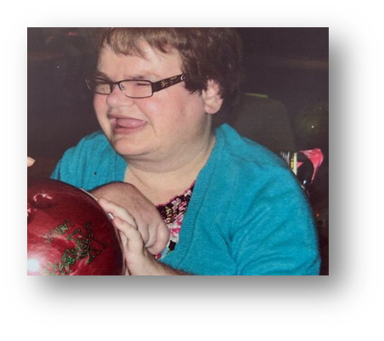
Case
study
Rachel Johnston lived and was cared for in a community residential facility.
Rachel had many dental problems and it was decided she needed extensive dental treatment.
Rachel collapsed hours after discharge from hospital following a general anesthetic where all her teeth were extracted.
She died 10 days after her life support was turned off.
Notes:
Rachel Johnston lived and was cared for in a community residential facility.
Rachel had many dental problems and it was decided she needed extensive dental treatment.
Rachel collapsed hours after discharge from hospital following a general anesthetic where all her teeth were extracted.
She died 10 days after her life support was turned off.
Our aim should be to prevent our clients needing extensive dental treatment, so situations like this can be avoided

Slide 25

Activity
You have a new resident admitted to your setting, what would be the first thing you would do in terms of mouth care?
Answer :-
Complete mouth care assessment and care plan
Notes:
Now a short activity – consider the following:-
You have a new resident admitted to your setting, what would be the first thing you would do in terms of mouth care?
Answer :-
Complete mouth care assessment and care plan

