Slide 1
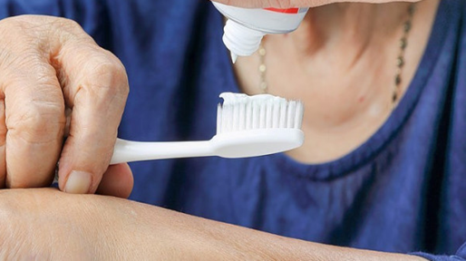


Mouth Care Matters in the Community
Section 4
Mouth Care for People with Dysphagia, peg fed or nil by mouth
Notes:
Mouth Care Matters in the community Section 4 - In this section we will cover mouth care for people with dysphagia, are peg fed or are nil by mouth Dysphagia is a medical term for a swallowing difficulty. This is a difficulty moving food or drink from the mouth to the stomach.
Some people with severe dysphagia are unable to be fed orally and are fed via a feeding tube. Mouth care is especially important for these clients.

Slide 2



This slide set has been produced by the following partner organisations for use within the Northwest Region
Disclaimer
The authors take no responsibility for any actions undertaken when following this guidance. Health and Social Care professionals should only carry out procedures that they are trained in and that are within their competencies.
Mouth Care Matters - SECTION 4
Editor(s) | Health Education England – Queries /comments should be emailed to DWT@nhs.net
Contributors | Lesley Gough, Lynne Smith, Vicky Brand, Sue Hodgkiss, Helen Parsley and Emma Stonier
Version | 2
Issue date | October 2020
1st Review Next Review | October 2023 October 2025
Notes:
This training material has been developed by the following organisations for use across the north west of England

Slide 3

Learning outcomes
Participant will gain an increased knowledge and understanding of:
Common causes of dysphagia or swallowing difficulties
Symptoms of dysphagia
Mouth problems in clients with dysphagia or nil by mouth
Mouth care for clients with dysphagia or nil by mouth and products to help with mouth care
Notes:
In this section the participant with gain an increased knowledge and understanding of:
The common causes of dysphagia or swallowing difficulties
Symptoms of dysphagia
Mouth problems in clients with dysphagia or are nil by mouth
Mouth care for clients with dysphagia or nil by mouth and products that can assist mouth care

Slide 4
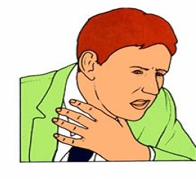
Common Causes of Dysphagia or swallowing difficulties
Neurological – stroke, Parkinson’s disease, multiple sclerosis, dementia, or a brain injury.
Congenital and developmental – Learning disability, cerebral palsy, cleft lip/palate
Obstructive – cancer (mouth, throat), pharyngeal pouch, scarring from radiotherapy
COPD
Oral causes – mouth ulcers, dry mouth (xerostomia), poor lip seal
Notes:
Causes of dysphagia or swallowing difficulties.
There are many causes of dysphagia, but the most common causes include : (click)
Neurological causes –such as stroke, Parkinson’s disease, multiple sclerosis, dementia or a brain injury (Click)
Congenital and development disorders – such as learning disability, cerebral palsy, cleft lip or palate
Obstructive causes – such as mouth or throat cancer. A pharyngeal pouch – this is where food or drink collects in a pouch or pocket in the throat. If food is suddenly released while the airway is open this will cause a swallowing problem. (Click)
Chronic obstructive Pulmonary disease or COPD is a disease of the lungs, but this can cause swallowing problems Someone with COPD may become very tired and short of breath just from eating a meal. This can cause them to swallow and then immediately need to breath in because of their shortness of breath. This can result in food or drink being breathed in or aspirated into the lungs. (Click)
Oral or mouth problems that can cause swallowing difficulties include having a very sore mouth, perhaps due to ulcers or chemotherapy, having a very dry mouth or poor lip seal

Slide 5
Symptoms of Dysphagia
Coughing during meals
Choking/Drooling
Gurgly voice
Pocketing of foods in the cheeks
Food avoidance
Prolonged mealtimes
Weight loss
Poor tongue control during chewing or difficulties pushing food to back of throat
Loss of sensation of food/liquid in mouth
Stagnation of food in mouth
Aspiration pneumonia - risk of aspiration from food and drink accompanied by poor oral hygiene and night-time denture wearing (Muller2014)
Notes:
Symptoms of dysphagia
If someone has a swallowing difficulty you may find they have the following problems:-
They may - Cough or choke during meals, or it may cause them to drool
They may have a gurgly voice and food may collect in their cheeks
The client may also avoid certain foods as they know it is difficult to swallow and mealtimes can become very prolonged
You may also notice your client has weight loss due to them not eating enough
A client with dysphagia may have very poor tongue control during chewing or they may experience difficulties pushing food to back of throat
They may also have little or no sensation of food/liquid being in the mouth and this can cause a build up or stagnation of food in the mouth particularly in the cheeks
Research shows that people with dysphagia are at an increased risk of chest infections and pneumonia because of food and drink being aspirated or breathed into the lungs. This can be made much worse if the client has poor oral hygiene and wears denture at night.

Slide 6
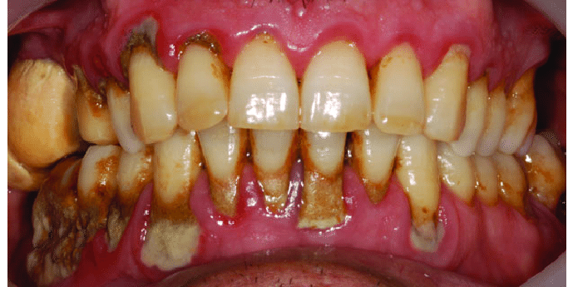
Mouth problems in clients with Dysphagia or Nil by Mouth
Nil By Mouth residents can form calculus/tartar more quickly. Good toothbrushing to remove plaque before it hardens will prevent this.
Also higher risk of tooth decay and gum problems if suffers with dry mouth
NBM – Higher risk of oral infections such as thrush
Some thickening agents contain sugar and will cause tooth decay. If given at mealtimes 3-4 times daily, not usually a problem
Take guidance regarding thickeners from SaLT team and use thickener recommended from the swallow assessment
Notes:
People who are NBM can form calculus or tartar more quickly and it may be difficult to remove.
Good tooth brushing will prevent this as it will remove the plaque (the soft deposits) before it hardens and becomes calculus. In this slide we can see large amounts calculus particularly on the back teeth and at the gum margins. The gums are very red and puffy because of gum disease
Clients with dysphagia or are NBM very often suffer from a dry mouth. This means they are at greater risk of tooth decay and gum disease and are also at a higher risk of oral infections such as thrush
People with swallowing problems often have their food and drinks thickened to aid swallowing. Some thickening agents contain sugar and can cause tooth decay, but if these are given at mealtimes, the frequency of 3-4 times daily is not usually a problem.
Always take guidance regarding thickeners from the speech and language team and use the thickener recommended from the swallow assessment.

Slide 7
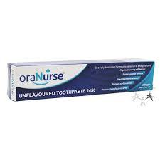
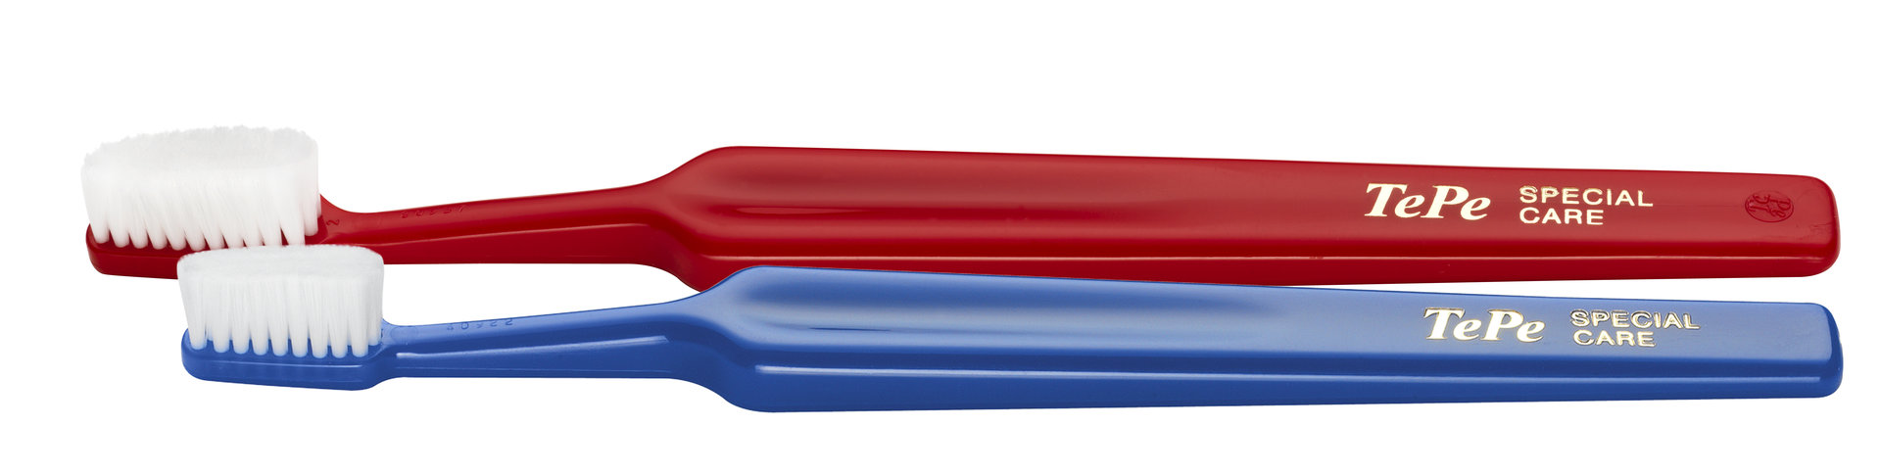

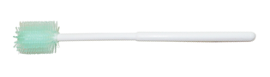
Mouth care for clients with Dysphagia or Nil by Mouth
Regular mouth care very important – at least 2 x daily brushing with fluoride toothpaste
Can have Sensory aversion. Consider very soft toothbrush e.g. Oralieve 360º and flavourless toothpaste e.g. OraNurse
May need to remove excess debris from mouth before brushing – Mouthese stick
Consider posture – ideally sitting upright or at least head raised and turned to one side to aid drainage.
Notes:
Regular mouth care is very important for clients with dysphagia or are NBM and mouth care should be carried out at least twice a day using a fluoride toothpaste.
Clients may develop a highly sensitive mouth and can be very defensive to mouth care. This can be avoided by gradually increasing the amounts of regular mouth care and using a very soft toothbrush for example an Oralieve 360 or Tepe special care toothbrush. A mild or unflavoured toothpaste such as OroNurse is also useful
Before toothbrushing it maybe necessary to remove excess debris from mouth. This can be done using a Mouthese stick or damp gauze wrapped around a gloved finger (if safe to do so).
Always consider posture and head position of the client before starting mouth care. Ideally the client should be sitting upright in a stable position. If unable to sit the clients' head should be raised and turned to one side to aid drainage and to prevent aspiration.

Slide 8
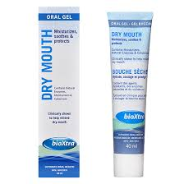
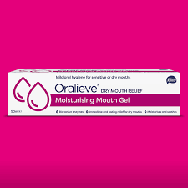
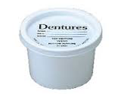
Mouth care for clients with Dysphagia or Nil by Mouth cont’d
Suction Toothbrushes - have a suction tube connection and are excellent to remove any secretions during brushing.
Consider dry mouth gel to moisturise soft tissues after cleaning and especially at night
Ensure good denture care and remove at night keep
in named denture pot
Notes:
Suction toothbrushes – These toothbrushes have a suction tube connection and are excellent to remove any secretions during brushing. They have soft bristles on one side and a foam pad, to clean soft tissues on the other.
People who are nil by mouth frequently suffer from dry mouth. Consider using a dry mouth gel such as Oralieve or Bioextra to moisturise soft tissues after cleaning and especially at night
Ensure good denture care and any dentures should be removed, cleaned separately and stored in a named denture pot at night.

Slide 9
To summarise this section:
There are many causes of dysphagia or swallowing difficulties.
The symptoms of dysphagia include chocking during mealtimes, weight loss and an increased risk of chest infections and pneumonia
Clients with dysphagia or are nil by mouth can form calculus/tartar more quickly and are at a greater risk of dry mouth and oral infections
Regular mouth mouth care is very important with 2 x daily brushing with a fluoride toothpaste.
Products such as low foaming/flavourless toothpaste and suction toothbrushes can help with mouth care
Summary
Notes:
To summerise this section
There are many causes of dysphagia or swallowing difficulties.
The symptoms of dysphagia include chocking during mealtimes, wight loss and an increased risk of chest infections and pneumonia
Clients with dysphagia or are nil by mouth can form calculus/tartar more quickly and are at a greater risk of dry mouth and oral infections
Regular mouth mouth care is particularly important with twice a day brushing with a fluoride toothpaste.
Products such as low foaming/flavourless toothpaste and suction toothbrushes can help with mouth care

Slide 10

Assessment
Tick 3 common symptoms of dysphagia:-
  Coughing during meals
  Prolonged mealtimes
  Weight gain
  Stagnation of food in the mouth
What problems can occur in the mouth in clients with dysphagia or are nil by mouth?
  Calculus/tartar can develop more quickly
  Can have a higher risk of a dry mouth
  Can have a higher risk of tooth decay
  All of the above
Notes:
Now a short activity – consider the following:-
You have a new resident admitted to your setting, what would be the first thing you would do in terms of mouth care?
Answer :-
Complete mouth care assessment and care plan

