Slide 1
MOUTH CARE MATTERS IN THE COMMUNITY Mouth care for people who are care-resistive and/or living with dementia Section 5
Notes:
Welcome to section 5 of the e-learning package Mouth Care Matters in the Community. – Mouth care for people who are care-resistive or living with dementia.
In this section we will cover why mouth care is essential for people with living dementia, the importance of consent and good communication and how to identify if someone with reduced capacity is suffering with mouth problems.

Slide 2
This slide set has been produced by the following partner organisations for use within the Northwest Region
Disclaimer
The authors take no responsibility for any actions undertaken when following this guidance. Health and Social Care professionals should only carry out procedures that they are trained in and that are within their competencies.
Mouth Care Matters - SECTION 5
Editor(s) | Health Education England – Queries /comments should be emailed to DWT@hee.nhs.uk
Contributors | Lesley Gough, Lynne Smith, Vicky Brand, Sue Hodgkiss, Helen Parsley and Emma Stonier
Version | 2
Issue date | October 2020
1st Review Next review | October 2023 October 2025
Notes:
This training material has been developed by the following organisations for use across the northwest of England

Slide 3
Learning outcomes
Participants will gain an increased knowledge and understanding of:
Mouth care for those who are care-resistive and/or living with dementia
Consent and capacity related to the Mental Capacity Act 2005, Deprivation of Liberty Safeguards and Lasting Power of Attorney
Equality and diversity
Identifying who may have mouth problems
Good communication
Package of care including carers, family and friends
How to access general dental care and dental charges
Tips for providing good mouth care
Notes:
Participant will gain an increased knowledge and understanding of:
Mouth care for those who are care-resistive or living with dementia
Consent and capacity related to the Mental Capacity Act 2005, Deprivation of Liberty Safeguards and Lasting Power of Attorney
Equality and diversity
Identifying who may have mouth problems
Good communication
Package of care including carers, family and friends
How to access general dental care and dental charges
Tips for providing good mouth care

Slide 4
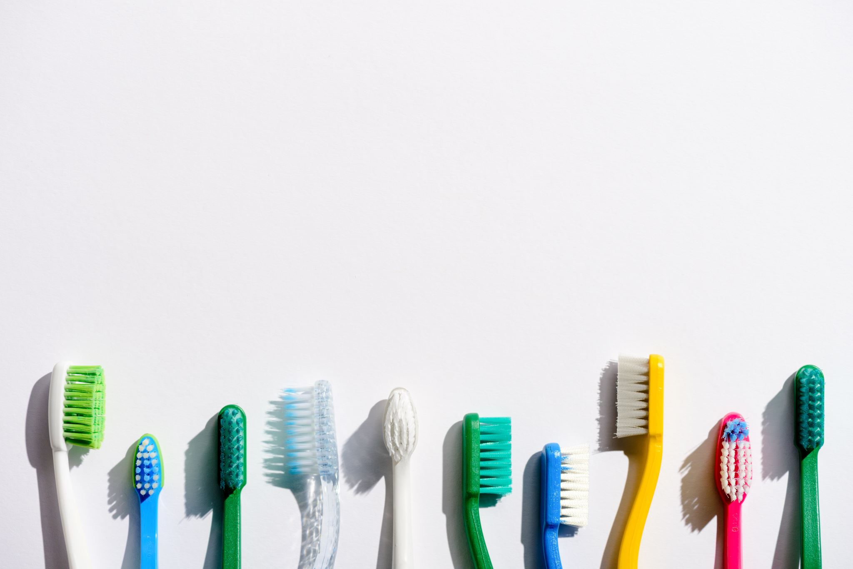
Mouth care for those who are care-resistive and/or living with dementia
Mouth care is an essential aspect of an individual’s daily care plan
All individuals must have access to dental care and preventive measures
Good mouth care and independence are linked
Loss of function impacts on people’s ability to care for their mouth
Dental disease increases quickly when someone is diagnosed with:
dementia
a degenerative illness
suffered a stroke
autism
acquired a brain injury
has a mental health condition
a severe learning disability
Notes:
Mouth care for those who are care-resistive or living with dementia
Mouth care is an essential aspect of care for people who may be resistant to mouth care interventions. It should be considered part of an individual’s routine daily care
Access to dental care and preventive measures should be instigated early to ensure comfort and prevent more serious problems and treatment complications
Good mouth care and good oral health and independence are linked.
Loss of function (physical or cognitive) can impact on people’s ability to care for their mouth and rapidly increase the risk of dental disease
The risk of dental disease increases quickly when someone is diagnosed with:
- dementia
- a degenerative illness
- suffered a stroke
- autism
- acquired a brain injury
- has a mental health condition
- a severe learning difficulty

Slide 5
Good daily mouth care is essential for wellbeing and will help to reduce hospital admissions
People with good oral health
stay independent for longer
recover from episodes of frailty more quickly
Poor oral health is linked with:
aspiration pneumonia
diabetes
coronary heart disease
strokes and peripheral vascular disease
Notes:
Good daily mouth care is essential for wellbeing and will help to reduce hospital admissions
People with good oral health stay independent for longer and recover from episodes of frailty more quickly
Poor oral health impacts on dignity, general health and wellbeing and quality of life, causing pain and discomfort, mood and behaviour changes, speech problems, the ability to smile, communicate, eat, swallow and can impact on self-confidence
Poor oral health is also linked with aspiration pneumonia, diabetes, coronary heart disease, strokes and peripheral vascular disease

Slide 6
Consent and capacity
All care staff must have a working knowledge of the Mental Capacity Act 2005 and their local policies and procedures in relation to capacity and consent.
Notes:
Consent and Capacity
All care staff must have a working knowledge of the Mental Capacity Act 2005 and their local policies and procedures in relation to capacity and consent.
It is important that capacity and consent is considered and recorded when conducting a mouth care assessment and an individual mouth care plan.
Capacity and consent should be reviewed on a continuous basis and record individual mouth care needs or preferences.
Dementia and other degenerative conditions can affect the ability to consent. They are broadly progressive and often there are good and bad days. This means that capacity can fluctuate day by day, an individual may lack capacity at one point in time but may be able to give consent another time.

Slide 7
Mental Capacity Act 2005
Is designed to protect and empower people whose condition or illness impedes their ability to make decisions about their own care and treatment. It applies to those aged 16 and over in England and Wales.
Notes:
Mental Capacity Act 2005
Is designed to protect and empower people whose condition or illness impedes their ability to make decisions about their own care and treatment. It applies to those aged 16 and over in England and Wales.
If a health or social care professional suspects an individual lacks capacity to decide, then they should follow the Mental Capacity Act 2005 and consider the legislation in relation to Deprivation of Liberty Safeguards and/or Lasting Power of Attorney.

Slide 8
Deprivation of Liberty Safeguards
Part of the Mental Capacity Act 2005
Aims to ensure that people who receive care and treatment in care homes, hospitals, supported living or other looked after settings do not have their freedom inappropriately restricted.
Notes:
Deprivation of Liberty Safeguards
The Deprivation of Liberty Safeguards are part of the Mental Capacity Act 2005. They aim to ensure that people who receive care and treatment in care homes, hospitals, supported living or other looked after settings do not have their freedom inappropriately restricted.
Where someone lacks capacity to decide about their care and treatment a Deprivation of Liberty Safeguard may be applied so that others can make a decision for them, in their ‘best interest’ to keep them from harm.
Unlawful deprivation of liberty is a breach of a person’s human rights.

Slide 9
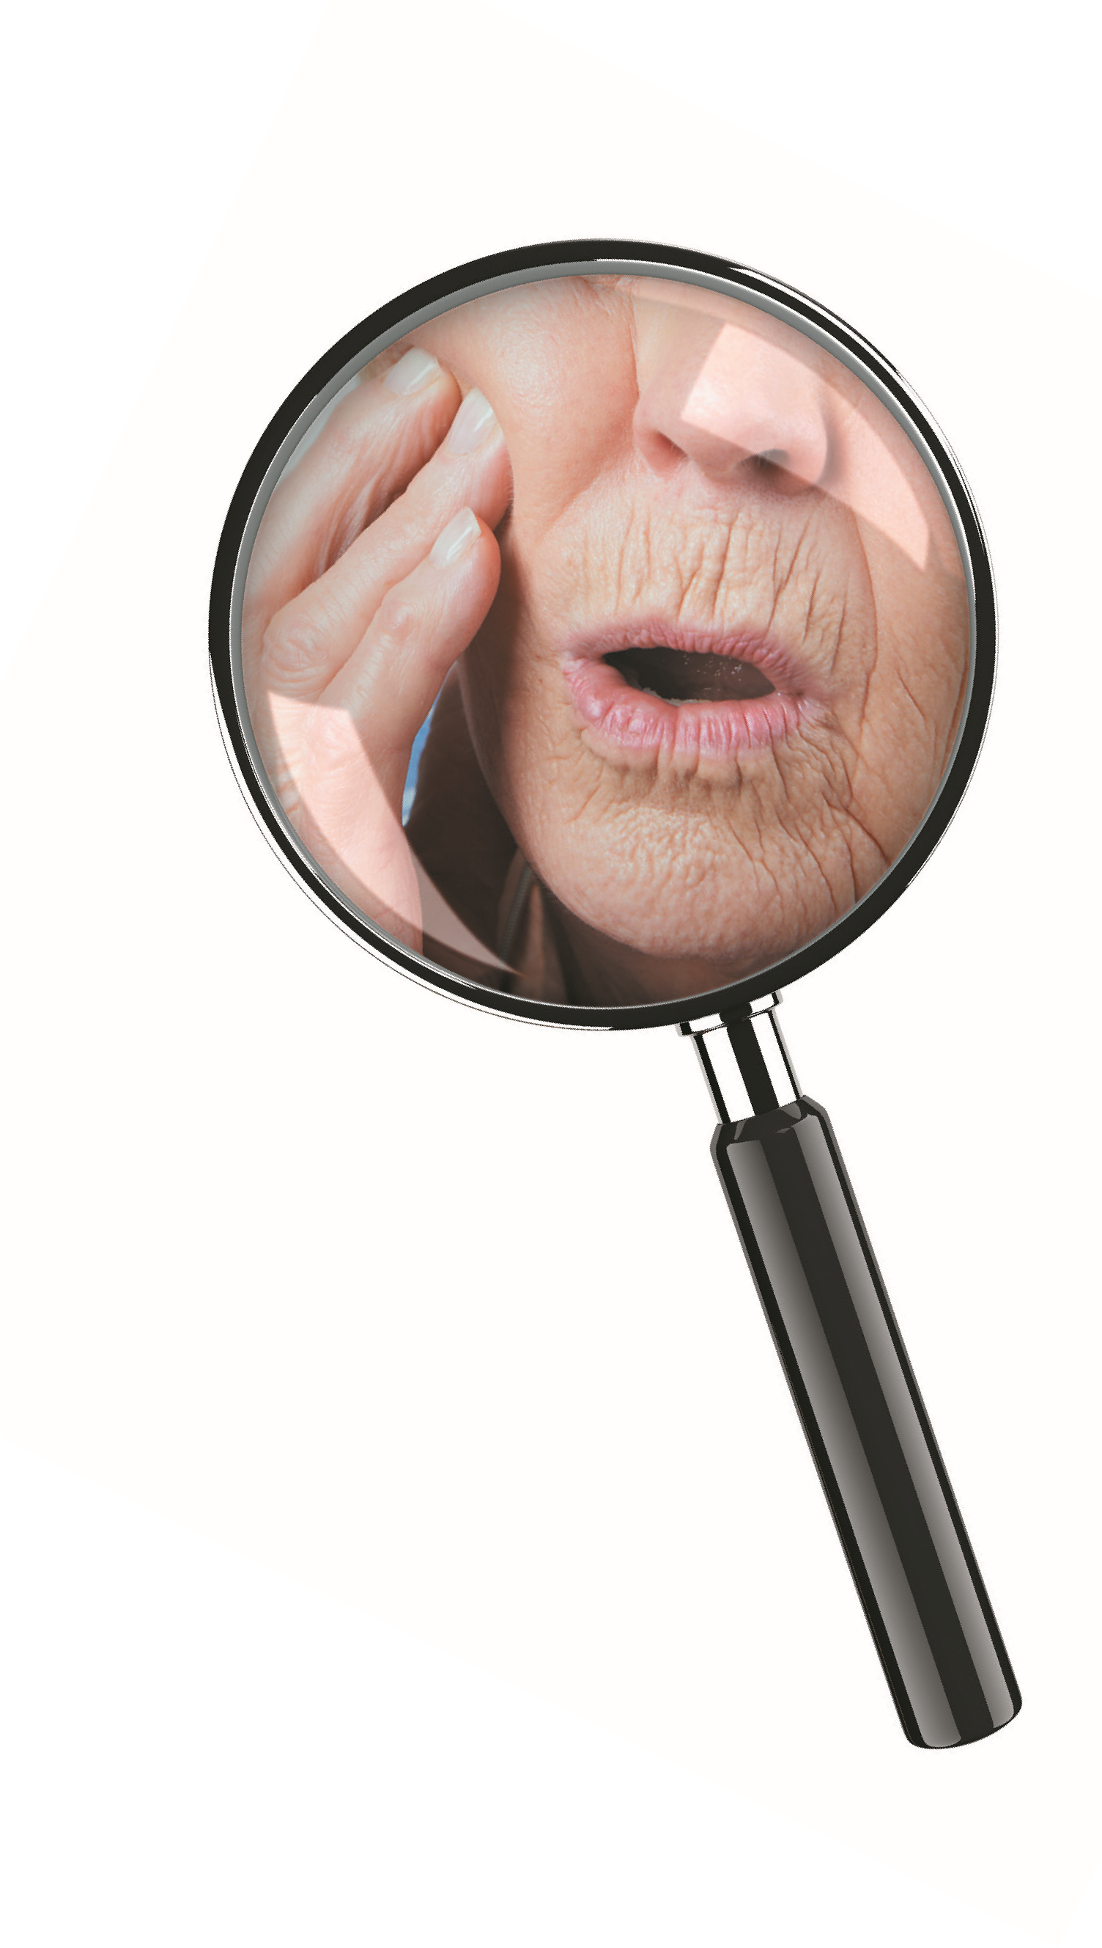
Lasting Power of Attorney Is a legal arrangement that the individual has authorised prior to any loss of capacity.
Lasting Power of Attorney
Notes:
There are two types of Lasting Power of Attorney, one that takes care of assets and financial affairs and the other health and welfare. Lasting Power of Attorney is a legal arrangement that the individual has authorised prior to any loss of capacity.
Lasting Power of Attorney for health and welfare enables a nominated family member or friend to legally make decisions on behalf of the individual regarding day to day care and wellbeing, these include, personal care and provision, medical and palliative care.
Adults who lack capacity and are not exempt from charges may have a nominated Lasting Power of Attorney for their assets and financial affairs, who will take responsibility for any dental charges.

Slide 10
Equality and diversity
All care establishments must be committed to an environment that promotes equality and embraces diversity in its performance as a service provider and adhere to legal requirements in relation to the Equality Act 2010 and associated protected characteristics.
Notes:
All care establishments must be committed to an environment that promotes equality and embraces diversity in its performance as a service provider and adhere to legal requirements in relation to the Equality Act 2010 and associated protected characteristics.
The care provider should attempt to make any reasonable adjustments to accommodate any individual with equality and diversity requirements.
For example: health, accessibility of appointments, providing translation or arranging interpreters and providing appropriate dental or medical products that don’t contain anything prohibited due to religious beliefs or lifestyle.

Slide 11
Identifying who may have mouth problems
This may be difficult when people are unable to effectively communicate and/or lack capacity.
You may observe the following behaviour changes, signs and symptoms:
Aggression
Refusal to eat and drink
Pulling of the ear or face
Head banging
Drooling
Grinding
Temperature
Swollen or bleeding gums
Odour or bad breath
Pimple/yellow spot at the side of the tooth which may ooze
Swelling of the face
Notes:
Identifying who may have mouth problems
This may be difficult when people are unable to effectively communicate or lack capacity
You may observe the following behaviour changes, signs and symptoms if someone is in pain due to a mouth problem
They maybe aggressive and Refuse to eat and drink
They may pull their ears or face and bang their head
They may Drool or Grind their teeth and the person may have a temperature.
In the mouth you may notice Swollen or bleeding gums and bad breath
There may sometimes be a Pimple or yellow spot at the side of the tooth which may ooze if pressure if applied and there maybe swelling of the face

Slide 12
Good communication
Help the person develop capacity to consent and be actively involved and informed:
using accessible information
extra time to explain
engaging with carers, family and friends
Making a ‘Best interest’ decision, the person conducting the mouth care assessment and proposing the mouth care plan needs to ensure that:
the reasons are accurately documented
with details of any other person(s) who may have to be consulted and involved
Further information
NHS accessible information standard https://www.england.nhs.uk/ourwork/patients/accessibleinfo-2/
Notes:
Good Communication
If a person has a communication problem, it is important to adjust the communication style or materials to meet specific needs or preferences. This may include providing information in alternative formats such as a different language, large print, easy read, pictures, braille, audio, sign language etc.
It may help by taking extra time to explain things and support the person to develop their capacity to consent and be actively involved and informed as much as possible.
With permission, engage with carers, family or friends to provide more details on their preferred communication requirements. If no information is available and communication is problematic, then advice should be sought from a speech and language therapist.
If a ‘best interest’ decision is needed, then the person conducting the mouth care assessment and proposing the mouth care plan needs to ensure that the reasons are accurately documented, along with details of any others who may have to be consulted and involved
Communication tips can be obtained from The NHS Accessible Information Standard webpage on the link shown here on the screen. This states that all organisations that provide NHS or publicly funded social care identify, record and meet the information and communication needs for those they care for, particularly where those needs relate to a disability, impairment or sensory loss.

Slide 13
Case Study 1 Mr Jones
Dementia case studies
Notes:
Dementia Case Studies The following case studies are actual incidents that occurred in the care system. These case studies highlight the importance of a mouth care assessment and care plan to keep our clients well and safe.
Case Study 1 – Mr. Jones Mr. Jones had recently moved into a nursing home from his family home following significant weight loss.
He had a diagnosis of dementia and depression, which had contributed to a poor appetite.

Slide 14
Assessment & care plan
On admission to the nursing home :
an assessment was completed
a care plan was implemented
Mr Jones was referred to a dietitian and a psychiatrist
The assessment failed to include mouth care needs and priorities
Mr. Jones wore full upper and lower dentures. He told the staff that he was able to manage and clean his dentures himself
Notes:
On admission to the nursing home an assessment was completed for Mr Jones to establish any health needs.
Following the assessment, a care plan was implemented, and Mr Jones was referred to the relevant services including a dietitian and a psychiatrist.
The assessment failed to include mouth care needs and priorities.
Mr. Jones wore full upper and lower dentures and he told the staff that he was able to manage and clean his dentures himself.

Slide 15
Impact
During lunch time one day Mr Jones appeared to be distressed and began choking and stopped breathing
The care staff were unable to establish why
Mr Jones collapsed and the care staff where unable to revive him
The paramedics pronounced him dead at the scene
The coroner’s report concluded that Mr Jones’s airway was occluded by his dentures which didn’t fit correctly, due to his significant weight loss
If a full mouth care assessment had been conducted on admission it would have identified that Mr. Jones’s dentures did not fit, a remedial plan and a referral to a dentist would have been made
This could have potentially prevented the death of
Mr. Jones
Notes:
During lunch time one day Mr Jones appeared to be distressed and began choking and stopped breathing. The care staff were unable to establish why.
Mr Jones collapsed and the care staff where unable to revive him, the paramedics pronounced him dead at the scene.
The coroner’s report concluded that Mr Jones’s airway was occluded by his dentures which didn’t fit correctly, due to his significant weight loss.
If a full mouth care assessment had been conducted on admission it would have identified that Mr Jones’s dentures did not fit, a remedial plan and a referral to a dentist would have been made.
This could have potentially prevented the death of Mr Jones.

Slide 16
Case Study 2 Maisie
Dementia case studies
Notes:
Dementia Case Studies
Case Study 2 – Maisie
Maisie was admitted to a residential care home following a hospital stay for a respiratory condition. She had been living in her own home with some limited support.

Slide 17
Assessment & care plan
Masie’s independence had reduced recently, she had lost weight and was becoming increasingly confused.
When she was admitted to the care home the assessment showed that she had a partial denture which she kept in overnight. This had resulted in oral thrush.
Her dementia meant that she often forgot to brush her teeth. She was reluctant to eat as her mouth was dry and sore.
Notes:
Maise’s independence had reduced recently, she had lost weight and was becoming increasingly confused.
When she was admitted to the care home the assessment showed that she had a partial denture which she kept in overnight. This had resulted in oral thrush, (a fungal infection that can thrive under a denture. It presents in the mouth as creamy white layer that is easily rub off, leaving an underlying redness inside the mouth).
Her dementia meant that she often forgot to brush her teeth. She was reluctant to eat as her mouth was dry and sore.

Slide 18
Impact
The care staff cleaned the denture and left it out overnight
They organised an antifungal treatment which cleared her oral thrush
They worked with Maisie to find the best time of day to clean her teeth
A saliva substitute, high fluoride toothpaste and lip moisturiser made her mouth more comfortable and helped her to eat
A month later Maisie was:
more comfortable
enjoying her food
putting on weight
Her family noticed that she was happier and more sociable
Notes:
The care staff cleaned the denture and left it out overnight which along with antifungal treatment cleared her oral thrush. They worked with Maisie to find the best time of day to clean her teeth and understand what she needed. A saliva substitute, high fluoride toothpaste and lip moisturiser made her mouth more comfortable and helped her to eat.
A month later Maisie was more comfortable, was enjoying her food and had put on weight. The recurrent respiratory conditions (chest infections) were no longer a problem. Her family noticed that she was happier and more sociable.

Slide 19
Package of care involving carers, family and friends
Good Practice
Engage carers, family and friends who may wish to be involved with all aspects of the mouth care assessment and the development and implementation of an individual mouth care.
Notes:
Package of care involving carers, family and friends
With permission, it is good practice to engage with carers, family and friends who may wish to be involved with all aspects of the mouth care assessment and the development and implementation of an individual mouth care plan. This should be supported and encouraged.

Slide 20
Facilitating access to dental care
Key points:
Everyone should see a dentist for a routine dental check-up at least once a year, even if they have no teeth
Preventive oral care optimises comfort and prevents more serious dental problems
Care staff should know how to access routine and urgent dental care services locally
The type of dental care that can be provided effectively on a domiciliary basis is restricted
Support from carers, family, or friends may be needed to enable individuals to access care at a local dental practice or clinic
Notes:
Facilitating access to dental care
Everyone should see a dentist for a routine dental check-up at least once a year, even if they have no natural teeth
It is important that dental care and preventive advice is sourced early from a dental care professional to improve comfort and prevent more serious dental problems
Care staff should know how to access routine and urgent dental care services locally
The type of dental care that can be provided effectively on a domiciliary basis, (this is where the dentist visits the client), is very much restricted
Support from carers, family, or friends may be needed to enable individuals to access care at a local dental practice or clinic

Slide 21
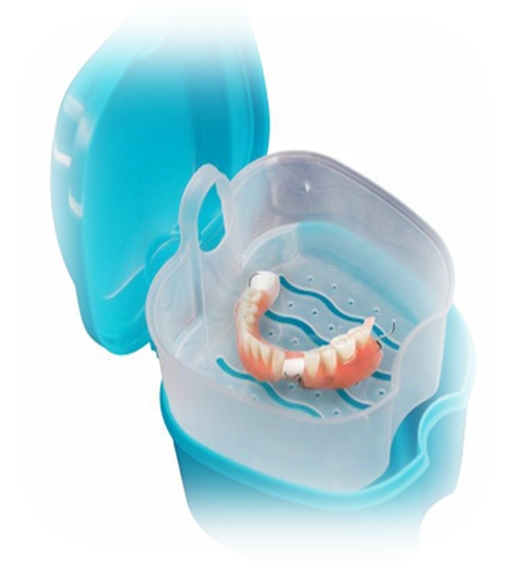
NHS dental care costs
NHS dental care has patient charges, that apply for all adults
Help with costs and exemptions may be available
Adults who have fully funded care packages can have help with charges (complete HC1 (SC) before dental examination, a certificate will be issued if the person doesn’t need to pay)
Adults who lack capacity and are not exempt from charges may have a nominated Lasting Power of Attorney for their assets and financial affairs, who will take responsibility for any dental charges
To find out about exemptions search for help with NHS health costs at:
www.nhs.uk
www.NHSBSA.nhs.uk
www.nhs.uk/NHSEngland/Healthcosts/Pages/Dentalcosts.aspx
Notes:
NHS dental care costs
NHS dental care from a family dentist or community dental service has patient charges, that apply for all adults, however, help with costs and exemptions may be available.
Adults who have fully funded care packages can have help with charges. A form (HC1 (SC)) is available to apply for before examination and a certificate will be issued if the person doesn’t need to pay.
Adults who lack capacity and are not exempt from charges may have a nominated Lasting Power of Attorney for their assets and financial affairs, who will take responsibility for any dental charges.
To find out about exemptions search for help with NHS health costs at the websites shown on the screen:-
www.nhs.uk
www.NHSBSA.nhs.uk
www.nhs.uk/NHSEngland/Healthcosts/Pages/Dentalcosts.aspx

Slide 22
Tips for providing good mouth care
Mouth care assessment with 24 hours
Record personal mouth care plan
Review & record every 3/12 months or when care changes
Offer denture marking for denture wearers
Access to regular dental care
Notes:
Tips for providing good mouth care
All individuals must have a mouth care assessment within 24 hours of accepting the client for care , regardless of their length of stay
Consider how the individual manages their daily mouth care, record the results of the mouth care assessment, daily needs and preferences in the client’s personal mouth care plan
Review every 3 months or sooner if needs or preferences change and amend individual care plans as appropriate
All individuals must be offered denture marking if required
Facilitate appropriate access to regular dental care

Slide 23
Tips Cont.
Individual care plan
Environment
Short bursts
Keep trying
Approachable
Desensitising
Document care
Notes:
Tips for providing good mouth care
Always refer to the individual’s mouth care plan and actively engage with carers, family and friends about mouth care routines
Ensure the environment is calm and free from background noise
Provide mouth care in short bursts. It may be necessary to clean one section of the mouth then try another section later – record which sections have been brushed
Do not force, keep trying and try different staff or different times of the day
Adopt approachable interpersonal skills, bring yourself slowly down to the individual’s level, maintain eye contact (if appropriate) and give reassurance with a friendly manner
Try desensitising techniques, these can help to build-up to brushing, it may take a few attempts of each stage the be accepted. Details of this can be found in section 3. Try showing pictures, and mimic the actions of toothbrushing
Document daily mouth care, both successes and refusals

Slide 24
Example prompt sheet
Notes:
This is an example of a prompt sheet that can be used with the client during assessment. It may also be useful as a quick guide to care staff, to inform of mouth care preferences. A copy can be found in your local mouth care toolkit.

Slide 25
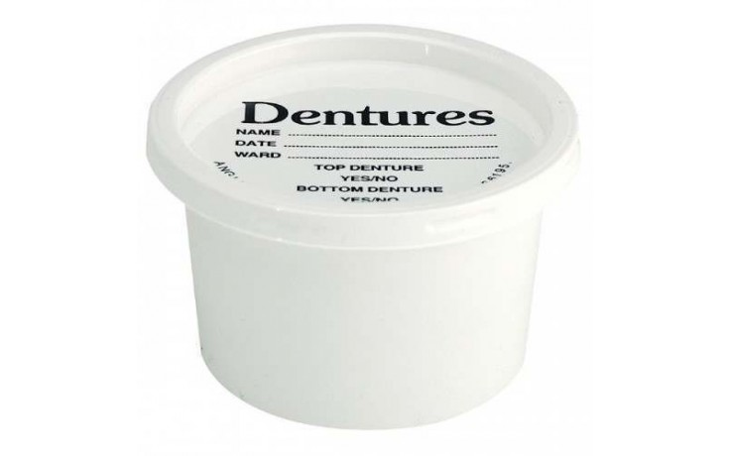
Dentures for those who are care-resistive and/or living with dementia
Many people with dementia may:
reach a stage when they struggle to use their denture
it may be in the individual’s ‘best interest’ that they are removed
this needs to be discussed with carers, family and friends to avoid distress
Relining old dentures can improve the fit providing a temporary solution.
It can be very difficult for people with moderate or advanced dementia to adjust to a new denture.
Notes:
Dentures for those who are care resistant and people living with dementia
Many people with dementia get to a stage when they struggle to use their dentures and it may be in the individual’s ‘best interest’ that they are removed
If the person is best not wearing dentures this needs to be discussed with carers, family and friends to keep them informed and avoid distress
Relining old dentures can improve the fit and provide a temporary solution. However, it can be very difficult for people with moderate or advanced dementia to adjust to any changes with their dentures

Slide 26
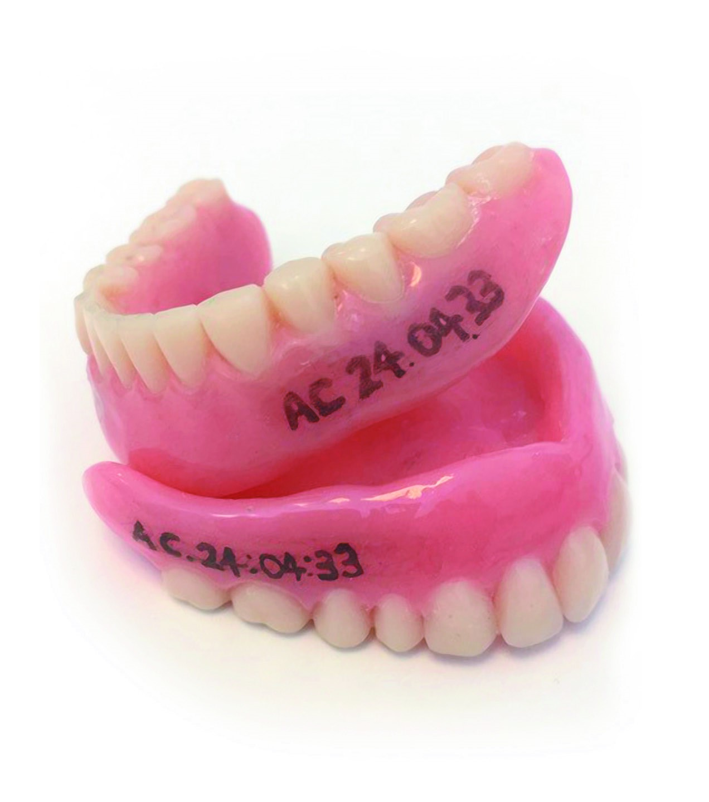
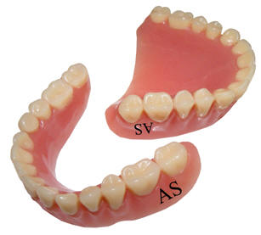
Keep dentures safe
Dentures can easily be mislaid causing:
great distress
difficulty eating
difficulty talking
Replacing a denture can be costly and it is often difficult
Vulnerable or an older person may struggle to adapt to a new denture
Offer denture marking
Notes:
Dentures can easily be mislaid in a community or residential care home. This can cause great distress, difficulty eating and talking.
- Replacing a denture can be costly and it is often difficult for a vulnerable or older person to adapt to a new denture, particularly if they have been without them for several weeks.
Offer denture marking, (instructions on how to do this are covered in section 7 – Mouth care for denture wearers).

Slide 27
Summary
Individual care plan within 24 hours
Essential mouth care for wellbeing
Facilitate access to dental care
Mental Capacity Act 2005
Extra time & care
Best interest decision
Review every 3 months or sooner if needed
Denture marking
Dementia, growing health issue
Notes:
To Summarise this section
- Dementia is a widely recognised and growing health issue
- Mouth care is an essential aspect of dementia care in all settings and should be considered part of an individual’s routine daily care
-Access to dental care and preventive treatments should be instigated early to ensure comfort and prevent more serious problems and treatment complications
- All care staff must have a working knowledge of the Mental Capacity Act 2005 and their local policies and procedures in relation to capacity and consent
- It may be that by taking extra time to explain things, using accessible information and engaging appropriately with carers, family and friends, that the person will develop their capacity to consent, or at least be actively involved and informed as possible
- If a ‘best interest’ decision is needed, then the person conducting the mouth care assessment and proposing the mouth care plan needs to ensure that the reasons are accurately documented, along with details of any other(s) who may have to be consulted and involved
- All individuals must have a mouth care assessment within 24 hours of arrival, regardless of their length of stay
- Consider how the individual manages their daily mouth care, record the results of the mouth care assessment and daily needs and preferences in the individual’s personal mouth care plan
- Review every 3 months or sooner if needs or preferences change and amend individual care plans as appropriate
-All individuals must be offered denture marking if required

