Slide 1
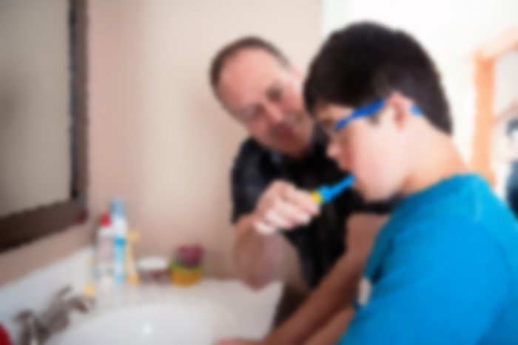
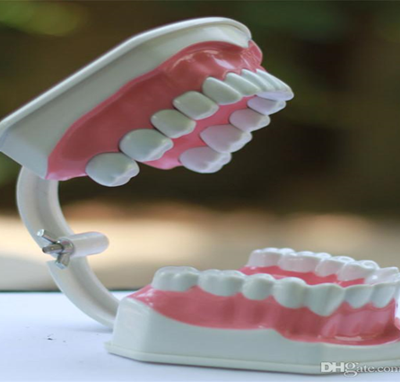
Mouth Care Matters in the Community Training for staff in the community Section 6 Personal mouth care for those with physical disabilities
Notes:
Welcome to section 6 of the e-learning package Mouth Care Matters in the Community. – Personal mouth care for those with physical disabilities.
In this section we will cover personal mouth care for those with physical disabilities, considering levels of dependence and practical tools for supporting oral hygiene.

Slide 2
This training material has been produced by the following partner organisations for use within the Northwest Region
Disclaimer
The authors take no responsibility for any actions undertaken when following this guidance. Health and Social Care professionals should only carry out procedures that they are trained in and that are within their competencies.
Mouth Care Matters - SECTION 6
Editor(s) | NHS England – Queries /comments should be emailed to DWT@nhs.net
Contributors | Lesley Gough, Lynne Smith, Vicky Brand, Sue Hodgkiss, Helen Parsley and Emma Stonier
Version | 2
Issue date | October 2020
1st Review Next review | October 2023 October 2025
Notes:
This training material has been developed by the following organisations for use across the north west of England

Slide 3
Section 6 Personal mouth care for those with physical disabilities
Learning outcomes
The participants will gain an increased knowledge and understanding of:
Assessing the level of dependence and the provision of the support required to meet the daily oral health needs of their clients.
Identify suitable oral hygiene aids to aid independence and ensure effective oral hygiene is carried out
Notes:
Learning outcomes
The participants will gain an increased knowledge and understanding of:
Assessing the level of dependence and the provision of the support required to meet the daily oral health needs of their clients.
Identify suitable oral hygiene aids to aid independence and ensure effective oral hygiene is carried out

Slide 4
‘The role of the carer is extremely important in the life of some people with physical disabilities. The knowledge and understanding that a particular carer may or may not have has a direct impact on how people with disabilities are enabled to develop competence and skills in choice and decision-making, and thereby gaining control over their own oral health’
(Owens and Marshman 2011).
The Role of the carer
Notes:
Based on a study in Sheffield by Owens and Marshman 2011, they concluded that……….
The role of the carer is extremely important in the life of some people with physical disabilities. The knowledge and understanding that a particular carer may or may not have has a direct impact on how people with disabilities are enabled to develop competence and skills in choice and decision-making, and thereby gaining control over their own oral health’

Slide 5
Practicalities of oral hygiene
When considering the practicalities of oral hygiene for individuals with a physical disability, it is important to use the principles of oral hygiene that would apply to everybody. However adjustments may need to be made to support independence where possible.
The main aims are to maintain the comfort and moisture of the mouth and keep it free from infection and pain so it is functional.
Before commencing oral hygiene, clients should be assessed for their level of dependence and their oral health status.
Notes:
When considering the practicalities of oral hygiene for individuals with a physical disability, it is important to use the principles of oral hygiene that would apply to everybody. However adjustments may need to be made to support independence where possible.
The main aims are to maintain the comfort and moisture of the mouth and keep it free from infection and pain so it is functional.
Before commencing oral hygiene, clients should be assessed for their level of dependence and their oral health status.
Adjustments may be toothbrush adaptations, bowl and towel to the chair or bed if unable to go to a sink.
To assess their oral status please see mouth assessment forms in your local guidance or section 3.

Slide 6
Physical disability and oral health
Physical disability can be caused by a wide variety of diseases and illnesses and may impact oral health in a number of ways.
Mobility problems can also mean that clients have difficulty accessing a sink area and prevent them from carrying out toothbrushing or denture care.
Notes:
Physical disability can be caused by a wide variety of diseases and illnesses and may impact oral health in a number of ways. Physical disabilities that affect the hands and arms such as arthritis and paralysis, Parkinson’s disease and cerabyl palsy, can have a particular affect on an individual’s ability to complete mouth care. This will in turn negatively impact their oral health status.
Mobility problems can also mean that patients have difficulty accessing a sink area and prevent them from carrying out toothbrushing or denture care.
It is important to fully assist an individual to maintain good oral hygiene, so their inability does not increase their risk of dental problems such as tooth decay and gum disease.

Slide 7
The level of support required for mouth care?
This should be assessed on an individual basis and not assumed.
Full assistance is required for those fully dependent on another person for mouth care.
Some assistance, these are clients’ that need some assistance due to a physical disability that may affect their manual dexterity.
Independent clients’ are able to look after their mouth and dentures on their own.
However clients should be assessed as being independent, if they can get out of bed, walk to the sink and brush their teeth without assistance.
The level of support required should be reviewed at regular intervals as this may change over time
Notes:
This should be assessed on an individual basis and not assumed.
Full assistance is required for those fully dependent on another person for mouth care. Those who may require full assistance include clients that are unconscious, those with severe learning disabilities and late stage dementia
Some assistance, these are clients’ that need some assistance due to a physical disability that may affect their manual dexterity. For example a tremor associated with Parkinson’s disease or those with a mild learning disability that need reminding about toothbrushing and require moderate support.
Independent clients’ are able to look after their mouth and dentures on their own. It must be appreciated that some clients think or do not want to disclose, that they might need some help with mouth care. Staff should to be sympathetic to these clients.
However clients should be assessed as being independent, if they can get out of bed, walk to the sink and brush their teeth without assistance.
The level of support required should be reviewed at regular intervals as this may change over time

Slide 8
Importance of Personal Protective Equipment (PPE)
When providing mouth care for residents/clients, PPE must be worn to prevent contact and droplet transmission.
Delivering mouth care is not an aerosol generating procedure, so PPE includes:
Disposable gloves
Plastic apron
Fluid resistant masks
Eye protection/visor
Some clients/residents may require use of enhanced PPE e.g. ventilated clients:
Eye protection/visor
FFP3 Respirator mask
Long-sleeved disposable gown
Gloves
Apron

Slide 9
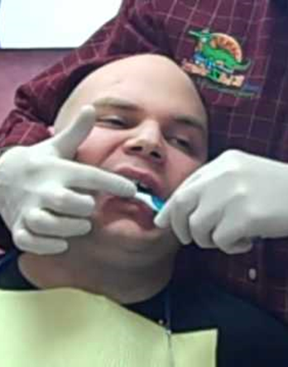
Brushing someone’s teeth
Wear PPE in accordance with infection prevention & control guidance
Approach at eye level, smile and explain what you are going to do
Check lips for dryness/cracking. Apply lip balm before mouth care
Remove any dentures and clean separately
If person is able, encourage them to brush their own teeth. Help may be needed to reach all areas.
If they can’t brush, make sure that the person is seated comfortably with their head supported, (on to your body or by another person)
Clients’ may cough when performing mouth care, be gentle, stand to side or behind client, take breaks to allow the client to rest and swallow
Notes:
The next slide gives some tips that may help if you have to brush someone elses teeth:-
Wear PPE in accordance with infection prevention & control guidance
Approach at eye level, smile and explain what you are going to do
Check lips for dryness/cracking. – if lips are dry and cracked, it is painful when they are stretched to brush teeth - Apply lip balm before mouth care
Remove any dentures and clean separately
If the person is able, encourage them to brush their own teeth. Help may be needed to reach all areas.
If they can’t brush, make sure that the person is seated comfortably with their head supported, (on to your body or by another person)
Clients’ may cough when performing mouth care, be gentle, stand to the side or behind client , take breaks to allow the client to rest and swallow

Slide 10
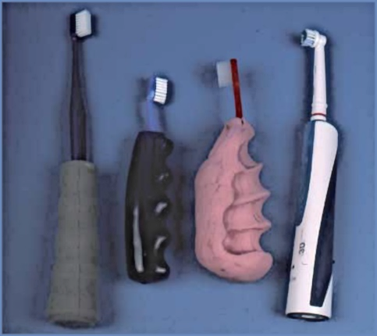
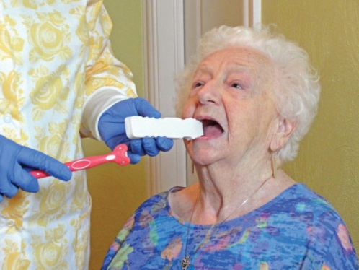
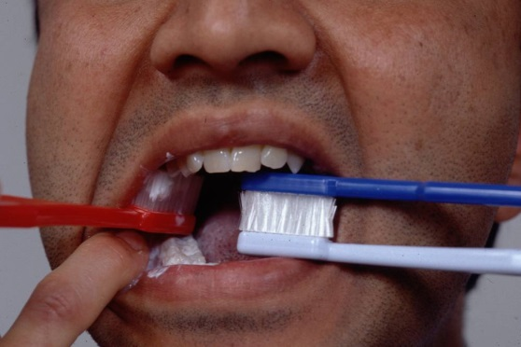
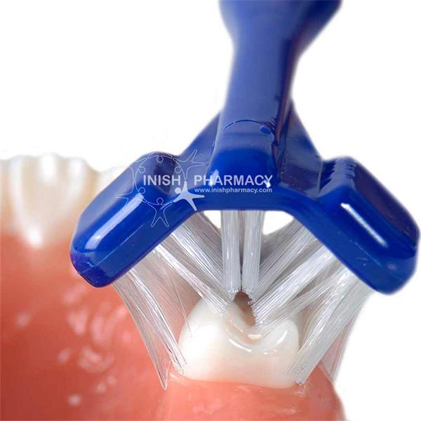
Brushing someone’s teeth cont’d…
Brushing someone’s teeth cont’d
Massaging the cheeks will encourage mouth opening
Brush all surfaces of upper and lower teeth beside the tongue, cheek and palate.
Encourage person to spit out toothpaste but don’t rinse
An electric toothbrush may be easier to use, (sometimes especially with sensory issues).
A brush with an adapted handle or multi-surface brush may also be helpful.
A mouth prop or 2 toothbrushes together, may help.
Notes:
Massaging the cheeks will encourage mouth opening- This gives a cue especially to clients with dementia or a learning disability that mouth care will happen
Brush all surfaces of upper and lower teeth beside the tongue, cheek and palate.
Encourage person to spit out toothpaste but don’t rinse
An electric toothbrush may be easier to use, (some people with sensory issues tolerate these well, others will not be able to accept the vibrations).
A brush with an adapted handle or multi-surface brush may also be helpful. The adapted handles make the width of the handle thicker and easier to use if someone has reduced manual dexterity. The multi-surfaces brushes, brush all the surfaces of the teeth at the same time. These are especially useful if you have limited time to brush, for example someone with dementia or a learning disability
A mouth prop or 2 toothbrushes together, may also help if the client tends to close onto the toothbrush. The mouth prop is placed in at the side of the mouth, keeping the mouth slightly open and allowing toothbrushing on the opposite side to the prop. It is then put on the other side of the mouth and toothbrushing carried out, again opposite the prop

Slide 11
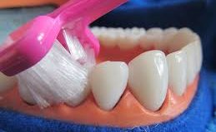
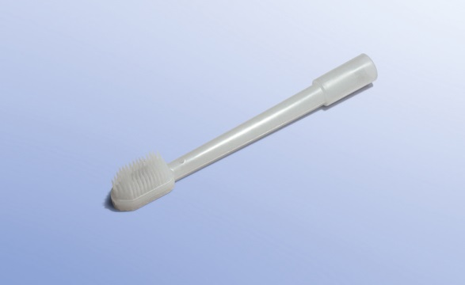
Oral Hygiene Aids
Three-headed toothbrush can be used for clients whose disability restricts movement and concentration.
An aspirating toothbrush is one that can be connected to the suction tubes and will help to remove excess saliva or water from the mouth during toothbrushing.
Notes:
Three-headed toothbrush can be used for clients whose disability restricts movement and concentration.
These toothbrushes simplify the toothbrushing technique by brushing multiple surfaces of a tooth at the same time, and therefore can be completed in less time. Three-headed toothbrushes should be used with toothpaste and placed over the teeth. A forwardbackwards motion is used to mechanically remove plaque from the teeth.
An aspirating toothbrush is one that can be connected to the suction tubes and will help to remove excess saliva or water from the mouth during toothbrushing.
These may be useful in unconscious or intubated clients who are at risk of aspirating. They should be used in the same way as a manual toothbrush using circular motions to clean all tooth surfaces. A non-foaming toothpaste will also reduce the amount of fluid generated during toothbrushing.

Slide 12
Oral Hygiene Aids cont’d..
Soft hand grips can be placed on a normal toothbrush to allow some independence
Some electric toothbrushes also have wider, thicker handles allowing those with limited dexterity to carry out their own mouth care
Notes:
Soft hand grips can be placed on a normal toothbrush to allow some independence
Some electric toothbrushes also have wider, thicker handles allowing those with limited dexterity to carry out their own mouth care

Slide 13
Superbrush
https://www.youtube.com/watch?v=EVy3zSAIxcY#action
Notes:
This video will show you how to use a three-headed toothbrush

Slide 14
Case Study : Barriers to Mouth Care
55 year old Ranj who has parkinsons was admitted to residential care and brought his powered toothbrush. He had problems with grip and difficulty brushing the left side of his mouth and required some assistance. Ranj was left to carry out his own oral hygiene. What problems do you envisage for Ranj and what changes should be made to his care so his oral hygiene needs are met?
Notes:
This slide is going into be in the assessment so we can asses level of knowledge gained ?

Slide 15
Summary
Levels of assistance vary between clients. A simple as prompt or reminder maybe enough to instigate oral hygiene
It is important to assist clients with their mouth care in a way that maintains their independence as it provides them with a sense of achievement and worth.
For some clients, particularly those who lack cooperation with mouth care or those with learning disabilities, assistance from visiting family members or carers may help.
Notes:
As we have discussed levels of assistance vary between clients. A simple as prompt or reminder maybe enough to instigate oral hygiene
It is important to assist clients with their mouth care in a way that maintains their independence as it provides them with a sense of achievement and worth.
For some clients, particularly those who lack cooperation with mouth care or those with learning disabilities, assistance from visiting family members or carers may help.

