Slide 1
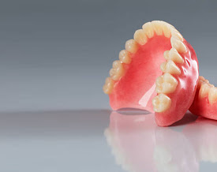

MOUTH CARE MATTERS IN THE COMMUNITY
Personal mouth care for an individual with a full and or partial denture
Section 7
Notes:
Welcome to section 7 of the e-learning package Mouth Care Matters in the Community. – Personal mouth care for an individual with a full or partial denture
In this section we will look at - The different types of dentures a person may wear, how to remove dentures from the mouth before cleaning, how to clean and store dentures, and how to mark a denture for identification purposes.

Slide 2



This slide set has been produced by the following partner
organisations for use within the Northwest Region
Disclaimer
The authors take no responsibility for any actions undertaken when following this guidance. Health and Social Care professionals should only carry out procedures that they are trained in and that are within their competencies.
Mouth Care Matters - SECTION 7
Owner | NHS England– Queries /comments should be emailed to DWT@nhs.net
Authors | Lesley Gough, Lynne Smith, Vicky Brand, Sue Hodgkiss, Helen Parsley and Emma Stonier
Version | 2
Issue date | October 2020
1st Review Next review | October 2023 October 2025
Notes:
This slide set had been produced by the partners shown below for use within the North West Region

Slide 3
Section7
Personal mouth care for an individual with a full and or partial denture
  Learning outcomes
  The participants will gain an increased knowledge and understanding of
  The different types of dentures a person may wear
  The removal of full or partial dentures from the mouth before cleaning
  The importance of cleaning dentures, the oral cavity and storing dentures when dentures are not in the mouth to maintain a good level of oral hygiene
  The importance of marking dentures adequately for identification purposes
  The importance of recording oral hygiene provision within the clients PCP
Notes:
Learning outcomes
The participants will gain an increased knowledge and understanding of
The different types of dentures a person may wear
The removal of full or partial dentures from the mouth before cleaning
The importance of cleaning dentures, the oral cavity and storing dentures when dentures are not in the mouth to maintain a good level of oral hygiene
The importance of marking dentures adequately for identification purposes
The importance of recording oral hygiene provision within the clients Personal Care Plan

Slide 4
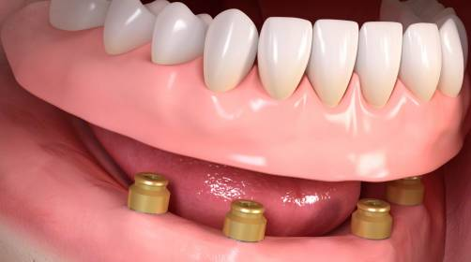
Full denture, made from pink or clear acrylic
Types of dentures
Full Denture
Partial dentures
Partial made from metal
(chrome)
Implant retained denture
Notes:
Types of dentures
There are many different types of dentures that may be seen in the mouth
A full or complete denture is one that replaces all the teeth in one arch as there are no natural teeth remaining.
A partial denture is made when only some of the teeth are missing and the client still has some natural teeth remaining.
Dentures maybe also made from different types of material including pink and clear acrylic or acrylic and metal or chrome as shown in these pictures
Implant retained denture – these dentures are becoming more common. The denture sits on small implants that are placed in the jaw. The denture usually has magnets on the fitting surface to keep the denture in place on the implant head

Slide 5


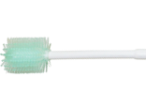
Denture care
Clients with dentures still require daily mouth care.
Dentures should be left out of the mouth over night in a labelled denture pot with clean water (changed daily)
The mouth should also be brushed gently with a small, soft toothbrush, moutheze stick or 360 toothbrush and rinsed well with water to remove debris
All oral hygiene care should be recorded in the PCP.
Notes:
Caring for dentures
Clients with dentures still require daily mouth care.
Keeping dentures clean is essential to keep them looking nice, to prevent mouth odour, to remove daily bacteria and food and to keep the lining of the mouth healthy.
Dentures should idealy be left out of the mouth over night in a labelled denture pot with clean water (which is changed daily)
The mouth should also be cleaned by brushing the soft tissues gently with a small, soft toothbrush, a moutheze stick or 360 toothbrush and rinsed well with water to remove food or debris
All oral hygiene care should be recorded in the Personal care plan.
Dentures should be removed at night, cleaned and stored in
water in a labelled denture pot.
Not all patients will be willing to follow this advice and it is important to respect the patient’s decision if this is the case. Keeping the denture out overnight will help to reduce the patient’s risk of oral candida (thrush).

Slide 6
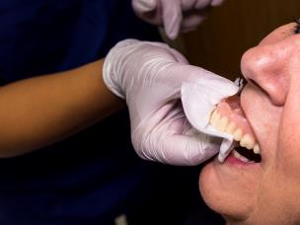
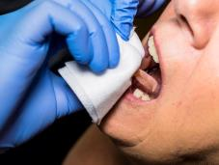
Removing a denture
Ask client to remove own denture
If client unable to remove, offer a sip of water and stand to front or side of client
Hold denture with fingers behind front teeth and thumb in front of teeth
Gently ‘rock’ denture until seal is broken and remove.
Or insert gloved finger into side of mouth to feel for edge of denture and gently pull down (for upper denture) or push upwards (for lower denture)
https://www.youtube.com/watch?v=ZudWyUgUiw0
Notes:
Removing a denture
If possible, ask the client to remove their own denture – even someone with advanced dementia can sometimes carryout this task
If the client unable to remove their denture, offer a sip of water and stand to front or side of client
Hold denture with fingers behind front teeth and the thumb on the outside of the front teeth
Gently ‘rock’ denture until seal is broken and then remove.
Alternatively insert gloved finger under the lip at the side of mouth to feel for edge of denture and then gently pull down (for upper denture) or push upwards (for lower denture), to dislodge it. Then remove dentures from the mouth
Please see link for a video to help with denture removal
A full/ complete denture is one that replaces all the teeth in one arch as there are no teeth remaining.
A partial denture is made when only some of the teeth are missing and the
patient still has some natural teeth remaining.

Slide 7
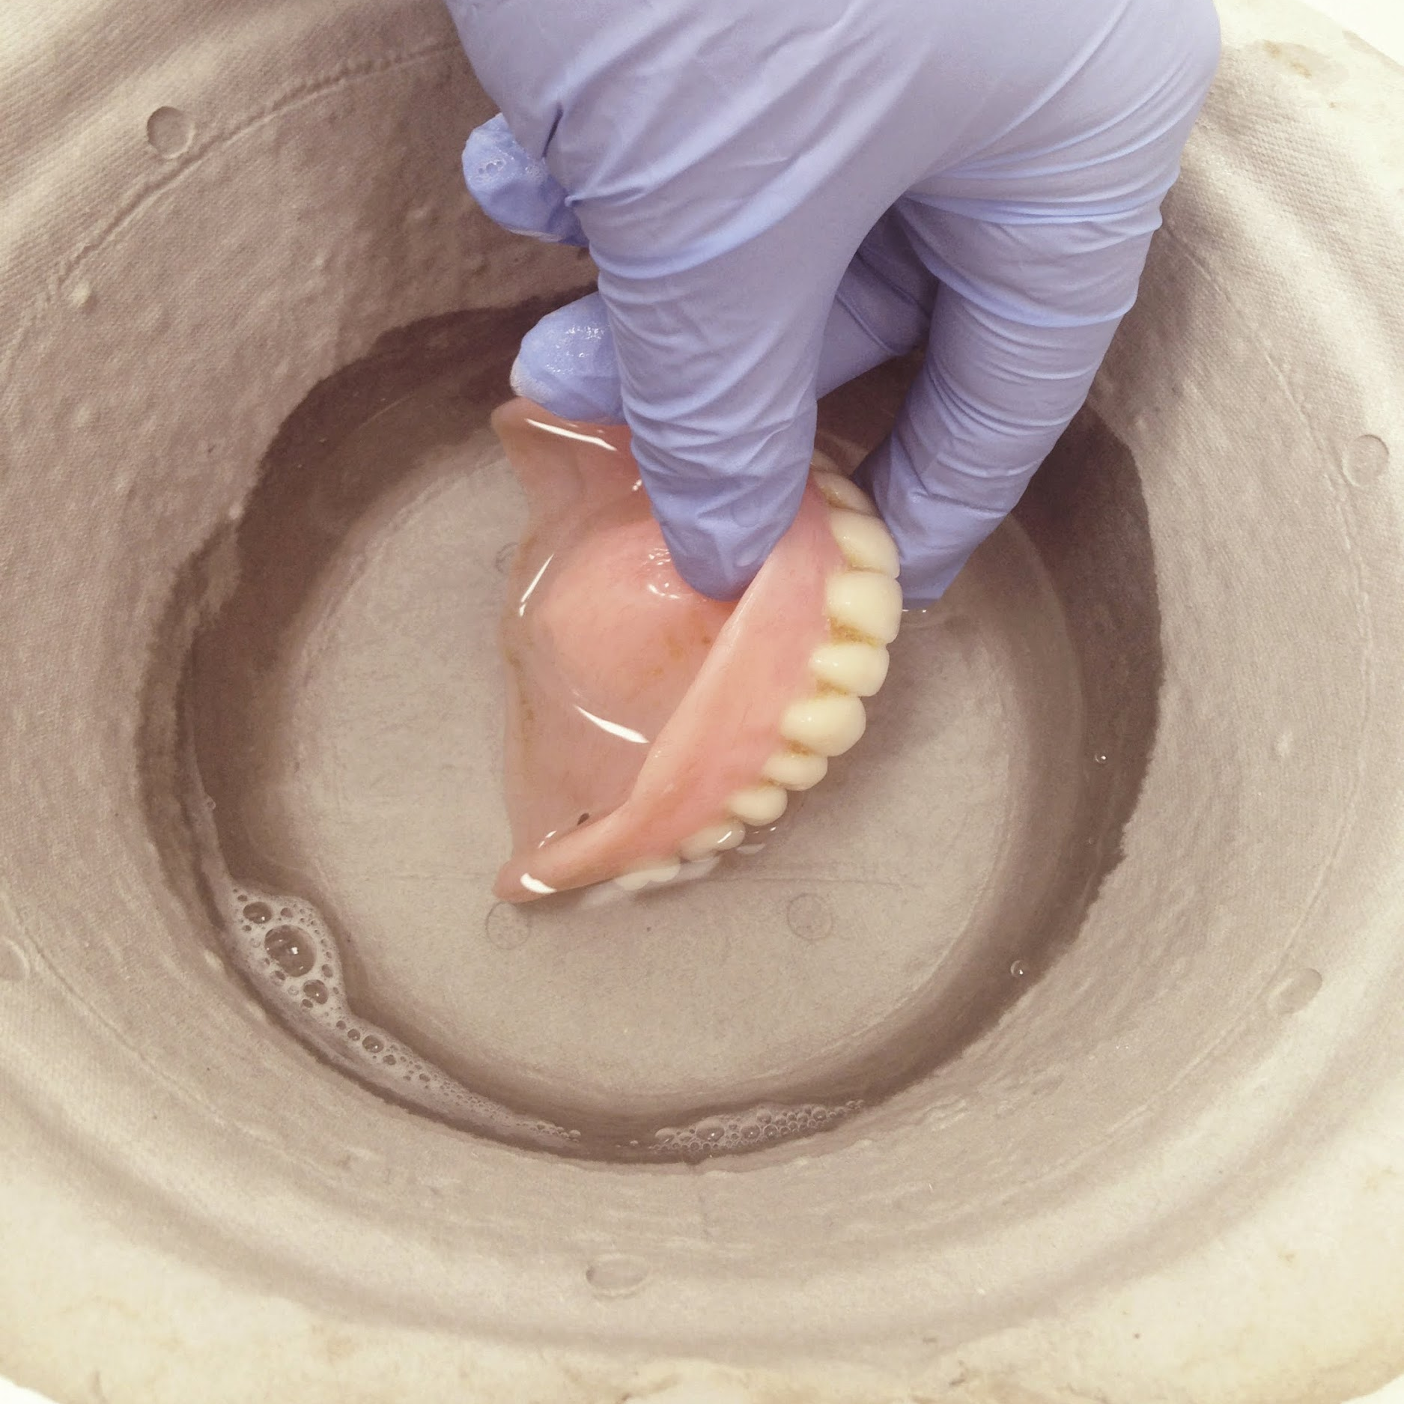
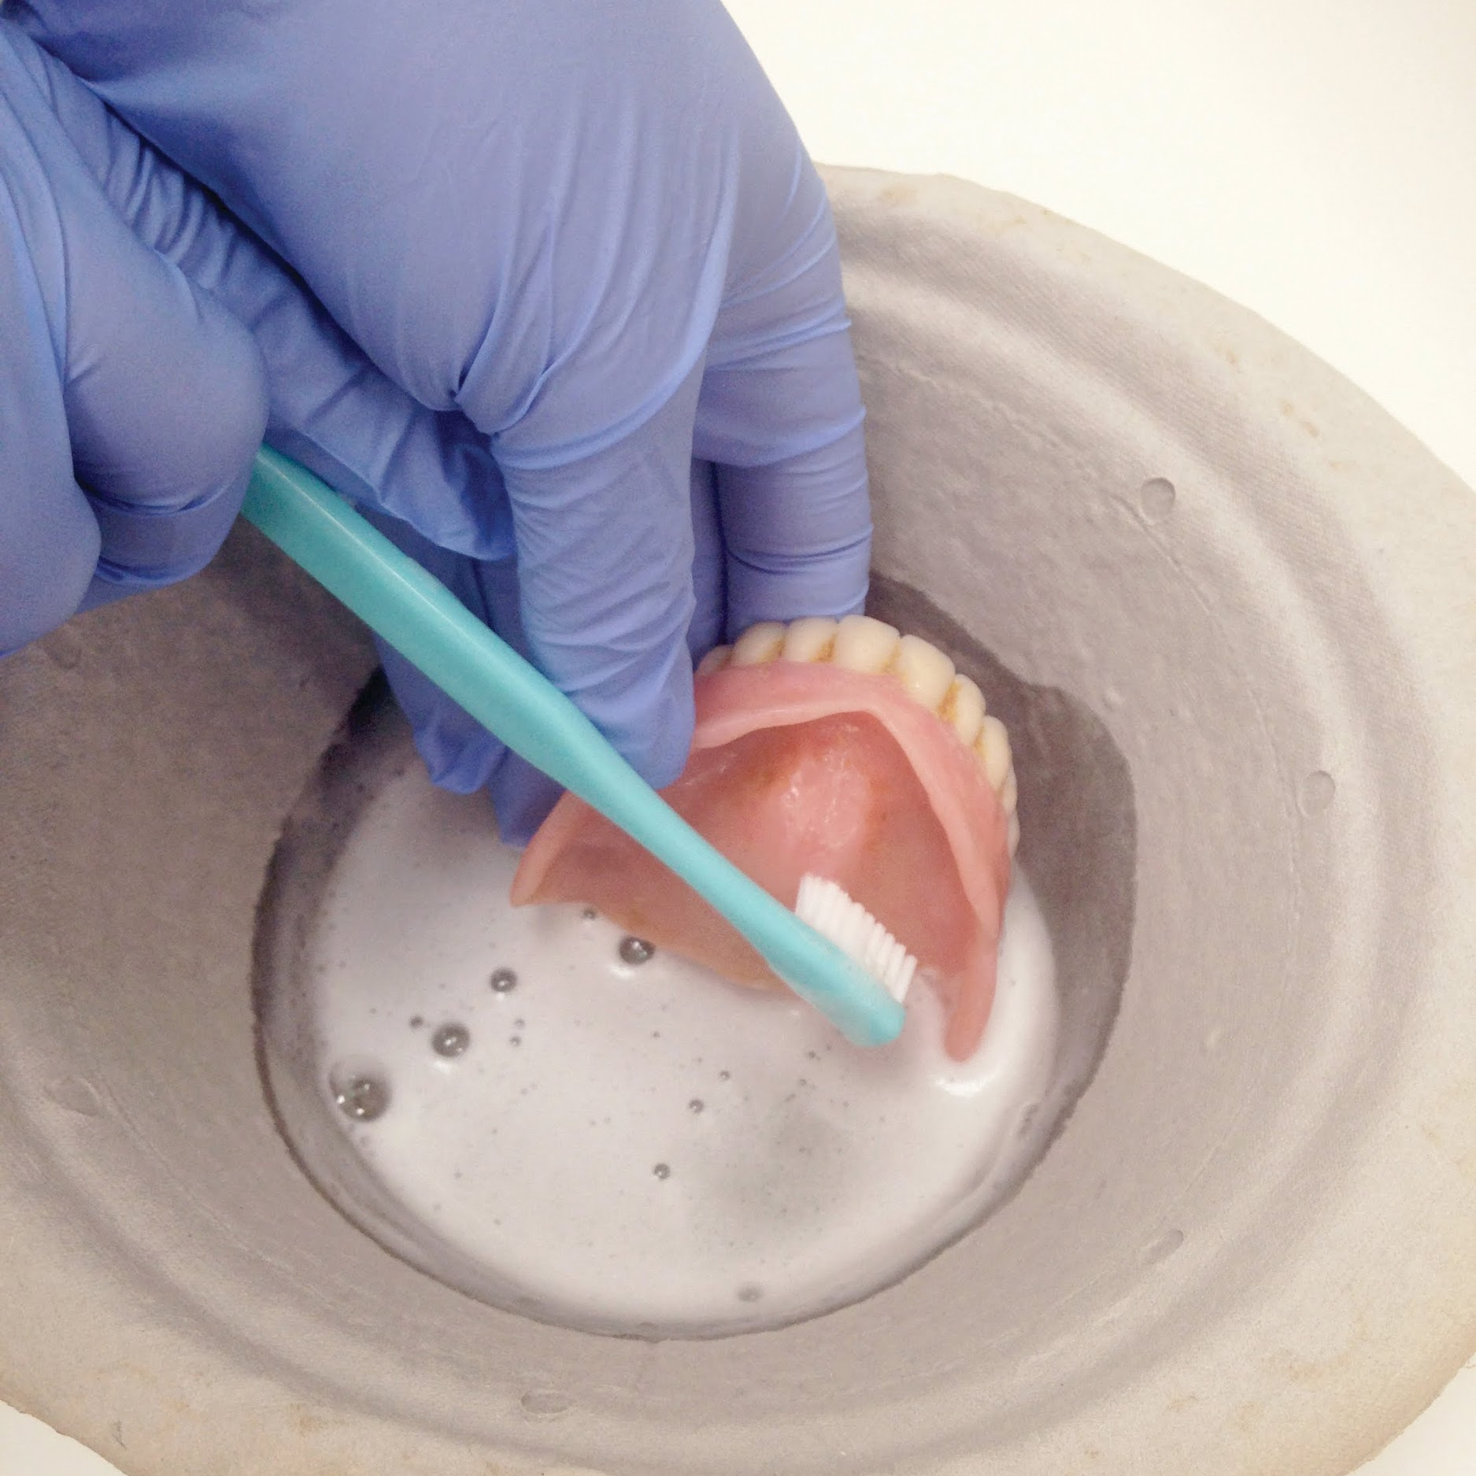
How to clean a denture
Always remove the dentures from the mouth before cleaning
Clean over a sink or bowl of water to prevent breakage if dropped
Clean with a denture brush or small toothbrush
Use unperfumed soap or denture cream(toothpaste can be abrasive)
Brush teeth and fitting surfaces, taking care not to bend any clasps
Rinse well
Place the denture back in the mouth during the day and in a named denture pot over night
Notes:
How to clean a denture
Always remove the dentures from the mouth before cleaning
Clean over a sink or bowl of water or cloth placed in the sink to prevent breakage if dropped
Clean with a denture brush or small toothbrush and Use unperfumed soap or denture cream (toothpaste can be abrasive)
Brush the teeth and fitting surfaces, taking care not to bend any clasps
Rinse the dentures well to remove any soap
Place the denture back in the mouth during the day and in a named denture pot over night
.

Slide 8
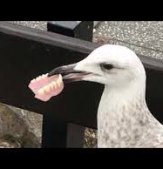
What is the impact of a lost denture?
Dignity
Eating/speaking
Comfort
But also:
Cost
Length of time without denture
Return visits
Difficulty adapting to new dentures
Notes:
What is the impact of a lost denture?
A lost denture impact on a person’s dignity – some people are never seen without their dentures, even by their loved ones. Being without their dentures can cause great distress
It will also Impact on eating or speaking – most people need their dentures to eat a varied diet. If dentures are lost, a soft or pureed diet may be needed. This can lead to a loss of interest in food or the refusal to eat. Some people also find it difficult to speak or be understood without their dentures
Comfort – some clients will have had dentures for many years and will not feel comfortable without them
But also:
A lost denture has a Cost impact– a basic NHS denture is a band 3 item and is currently just under £270. if a denture is lost the client, care home or hospital will have to pay for replacement
Length of time without denture – a new denture will take around 4 weeks to complete, so the client will be without teeth for this length of time
We must also consider Return visits - it takes at least 4 visits to make a new set of dentures. This means the client will have to be taken to the dentist or the dentist has to visit the client
It can also be difficult adapting to new dentures – new dentures take time to feel comfortable and may need repeat visits to the dentist to ease the dentures

Slide 9
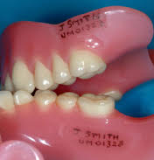
Denture Marking Process
Remove dentures from person’s mouth
Clean dentures in soapy water with toothbrush/denture brush
Disinfect denture by soaking in dilute Milton solution for 30 minutes (if a metal denture use a denture cleaning solution)
Dry denture and roughen area towards back of denture with a clean pan scrub
Use a pencil or indelible pen to write name or initials and DOB near back of denture. Wait to dry
Apply fine layer clear nail varnish, allow to dry
Rinse with water
Adapted from resources from RIS Healthcare and Salford Royal NHS foundation Trust. Reproduced with permission.
Notes:
Denture Marking Process
Dentures can be easily mislaid in the home or hospital and as we have discussed will cause distress, difficulty eating and speaking and are costly to replace. All dentures should be marked. There may seem little point if a client is in their own home, but if the person needs to be admitted to hospital or respite care, the dentures maybe lost or misplaced in these settings.
To put identification on a denture:-
Remove dentures from person’s mouth
Clean dentures in soapy water with a toothbrush or denture brush
Disinfect denture by soaking in dilute Milton solution for 30 minutes (if a metal denture use a denture cleaning solution)
Dry denture and roughen area towards back of denture with a clean pan scrub
Use a pencil or indelible pen to write name or initials and date of birth, near the back of denture. Wait to dry
Next apply fine layer clear nail varnish, allow to dry
Rinse with water

Slide 10

The Denture Sunflower
Denture sunflower picture is to help staff identify patients who wear dentures
Prompts carers to clean dentures and check not lost
Placed by the bedside or sink in their room.
Notes:
The Denture Sunflower
Denture sunflower picture is to help staff identify the clients or patients who wear dentures. This prompts carers to clean dentures and to make sure dentures are not lost.
The sunflower picture can be placed by the bedside or sink in the client’s room.
A printed sheet can be obtained from your local oral health improvement team and laminated

Slide 11
Failure to remove a dangerous denture
CASE STUDY
An 80-year-old man with a history of dementia, Parkinson’s disease and seizures
Admitted to hospital from his nursing home with a two-day history of shortness of breath.
He was unable to provide a history due to his dementia, although the possibility of aspiration, (swallow) of a denture was suggested by staff.
Examination revealed reduced air entry on the right side and a chest X-ray showed collapse of the right lung but no foreign body. He could not tolerate a chest CT as he was not able to lie flat due to breathlessness.
Due to his significant medical history palliative therapy was chosen and he died the following day.
Post-mortem revealed…
Graphic Photo Alert!!
Notes:
Next, we will look at a case study. In this situation there was a failure by care staff to remove a dangerous denture at night.
An 80-year-old man with a history of dementia, Parkinson’s disease and seizures was admitted to hospital from his nursing home with a two-day history of shortness of breath.
The patient was unable to provide a history of his shortness of breath due to his dementia, but staff reported that the lower denture couldn’t be found and it was suggested it could have been aspirated or swallowed it
An examination revealed, reduced air entry on the right side and a chest X-ray showed a collapsed right lung but no foreign body. The patient could not tolerate a chest CT scan as he was not able to lie flat due to breathlessness.
Due to his significant medical history, palliative care was chosen and he sadly died the following day.
A postmortem was carried out into the cause of death and this revealed…
The next slide is a Graphic Photo please look away if worried

Slide 12
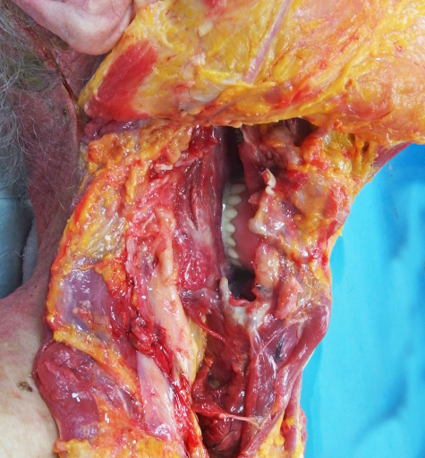
Sorry its graphic!
Notes:
This picture was taken during post-mortem of the patient. It clearly shows the lower denture is lodged in the patient’s throat

Slide 13
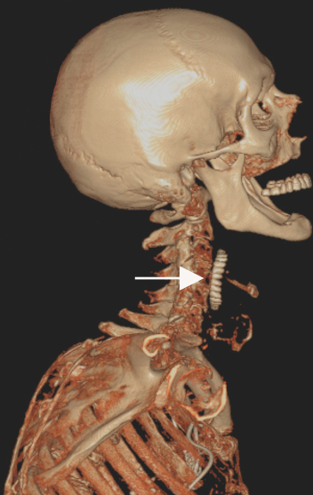
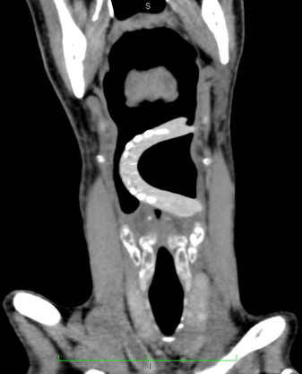
Notes:
And here we can clearly see the denture in the throat on the CT scan and X-ray. These were taken post-mortem

Slide 14
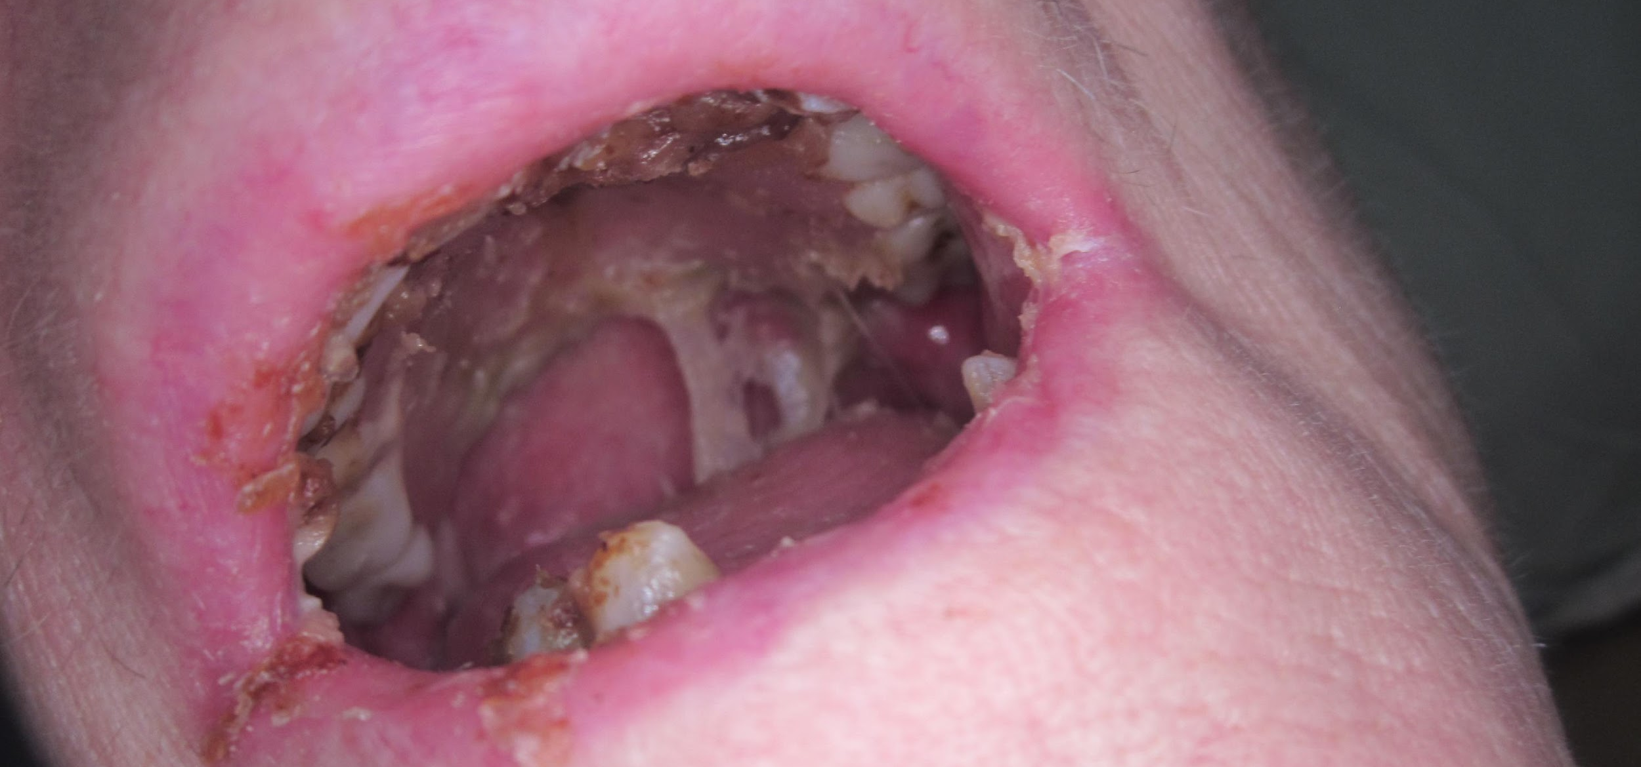
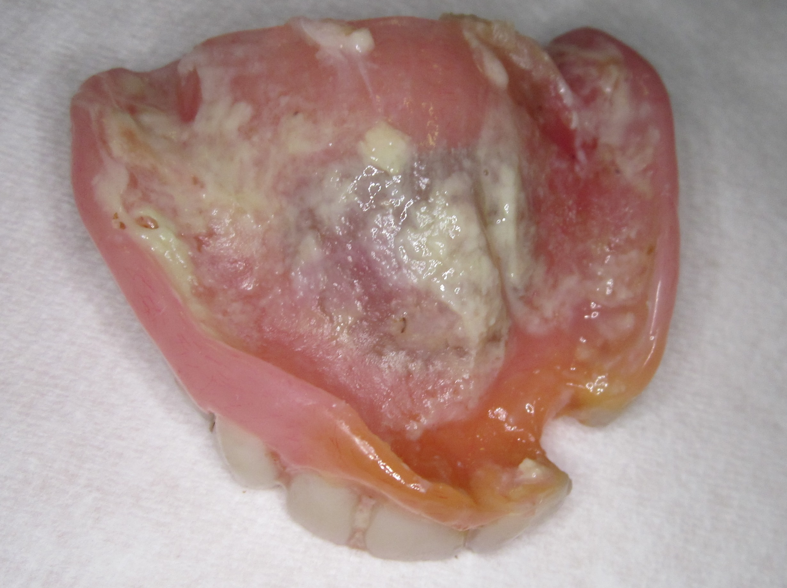
Case Study
64 year old female
Lives at home with 4 x daily POC
Previous history of stroke and limb weakness, dependent on care
Admitted to hospital with suspected chest infection and dehydration
Nursing staff concerned when reviewed on admission
A denture was present but not removed for months
Care staff unaware client had a denture
Notes:
The next case study is of a 64 year old female.
This client lived in her own home with 4 x daily Package Of Care
The client had a medical history of a stroke and limb weakness, and was fully dependent on her careers for all her personal care
She was admitted to hospital via the emergency department with a suspected chest infection and dehydration
The Nursing staff raised a concern of care when the condition of her mouth was examined.
If we look at the top picture we can see mouth and lips look extremely dry and painful There is also a denture was present in the mouth but it had not ben removed for months – the care staff were unaware the client had a denture
The denture was very dirty with food and bacteria present.
The client was unable to eat or drink as the mouth was too painful

Slide 15
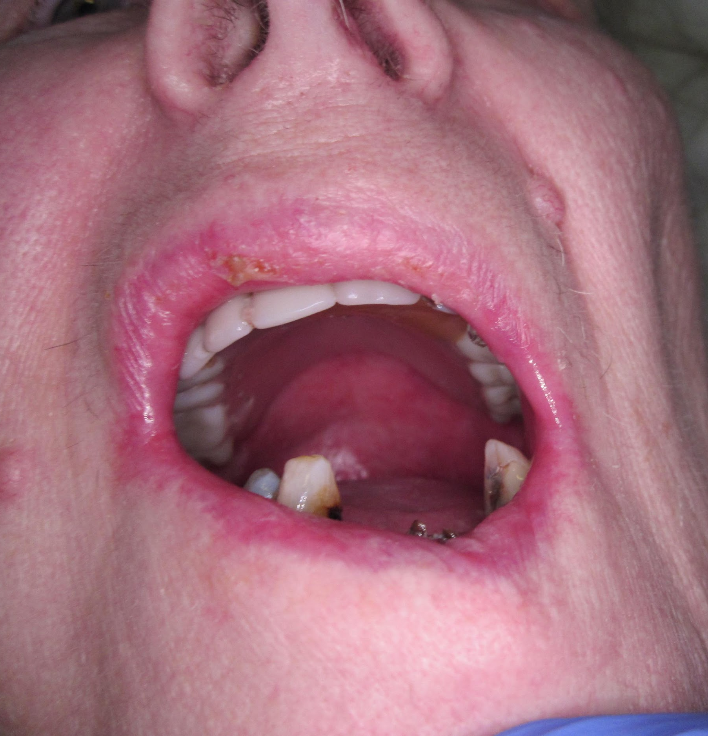
After mouth care treatment was complete
Notes:
The nursing staff carried out mouth care including applying dry mouth gel, brushing her teeth and cleaning the soft tissues and the denture. They also applied a lip balm to moisturise the lips. The patient was then able to eat and drink without pain.

Slide 16
Reflections
Dentures should be removed from the mouth and cleaned twice a day with a denture brush or toothbrush and soap
The mouth should be brushed with a small, soft toothbrush, moutheze stick or 360 toothbrush and rinsed well with water to remove any debris
Dentures should be removed at night and stored in water, in a labelled denture pot
Dentures should be marked with identifiable information
Notes:
To summarize this section:-
Dentures should be removed from the mouth and cleaned twice a day with a denture brush or toothbrush and soap
The mouth should be brushed with a small, soft toothbrush, moutheze stick or 360 toothbrush and rinsed well with water to remove any debris
Dentures should be removed at night and stored in water, in a labelled denture pot
Dentures should be marked with identifiable information such as name or initials and date of birth

